Slide 1
Chapter 3
Response of the Innate Immune System

Slide 2
Response of the innate immune system
1. Phagocytosis
Ingestion of extracellular particulate material Endocytosis Uptake by a cell of material from its environment  Plasma membrane expands (whole) => Phagosomes
=> Blood monocytes, neutrophils, & tissue MØ

Slide 3
Conti… Phagocytosis
Receptor-mediated endocytosis:  Extracellular molecules (specific cellular receptors)
Pinocytosis: cells take up fluid (any molecules)

Slide 4
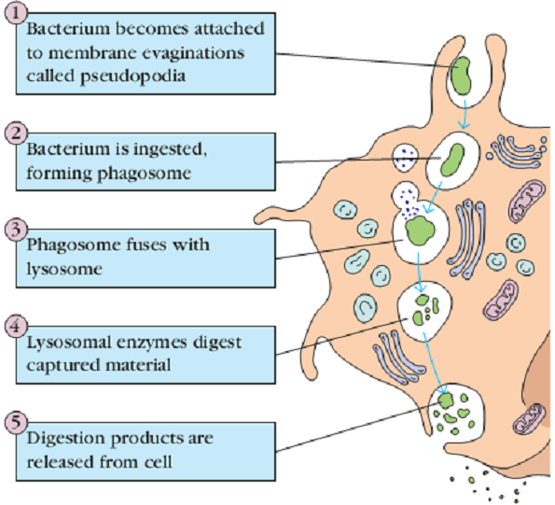
Phagocytosis

Slide 5
2. Inflammation
Tissue damage => wound or by an invading pathogenic Molecular component of a microbe (cell surface receptors)
Five => redness, swelling, heat, pain & loss of function
Repair & regeneration of new tissue (a/r end of inflammation)

Slide 6
Conti… Inflammation
Chemical initiate as mediators ☑ Invading microorganisms ☑ Released from damaged cells in response to tissue injury, ☑ Plasma enzyme systems, and ☑ White blood cells

Slide 7
conti… Inflammation
a. Histamine: chemical (variety of cells) => tissue injury
b. Kinins (small peptides in blood plasma - tissue injury)
 Bradykinin activate pain receptors on skin
c. Fibrin strands (Enzymes of the blood-clotting system) => prevents the spread of infection and bleeding

Slide 8
conti… Inflammation
Three => Vasodilation, Tissue swelling, & Influx of phagocytes
Vasodilation : An increase in the diameter of blood vessels
 Carry blood away (engorgement of the capillary network)
 Tissue redness (erythema) & ↑ tissue temperature

Slide 9
Conti… Inflammation
B. Tissue swelling:
Influx of fluid and cells (engorged capillaries → tissue)
=> Increase in capillary permeability Accumulation of exudate (fluid)=> tissue swelling (edema)

Slide 10
Conti… Inflammation
C. Influx of phagocytes: (capillaries into the tissues) => Increased permeability of the capillaries  Phagocytic cells accumulate  phagocytose bacteria => Lytic enzymes  damage nearby healthy cells  Pus (accumulation of dead cells, digested material, & fluid)

Slide 11
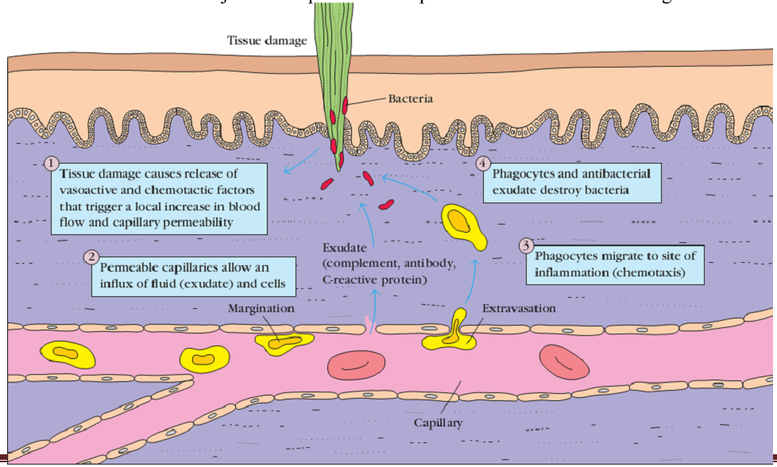
Inflammation

Slide 12
3. Complement
Humoral branch of the immune system  > 30 soluble & cell-bound proteins  Innate and acquired immunity
Basic functions:
Lysis of cells, bacteria, & viruses
Opsonization: opsonize bacteria & promotes phagocytosis

Slide 13
Conti… Complement
Triggering specific cell functions, inflammation, & secretion of immuno-regulatory molecules => specific complement receptors on cells
Immune clearance => Immune complexes - Circulation (spleen & liver) => Remove apoptotic cells

Slide 14
The components of complement system
Proteins and glycoproteins  liver hepatocytes, blood monocytes, tissue macrophages, & epithelial cells => Serum in inactive forms (pro –enzymes or zymogens)
Designated by letter symbols & numerals (C1–C9)
 Peptide fragments (a/r activation)  small letters

Slide 15
 Smaller fragment  “a” & the larger fragment  “b” => C2 is an exception
localized inflammatory responses  bind to the target
 Complement interact - functional (enzymatic activity)
 4 pathways: classical, lectin, alternative & membrane attack
=> activation of C5 convertase (C5b)  membrane attack pathway

Slide 16
Complement activation Pathways
I. Classical Pathway: soluble Ag-Ab complexes (immune complexes)
 C1, C2, C3, and C4 (in-active forms)
 IgM (Fc) – bind to C1
A. C1 activation:
C1 binds Ab (Ag) - C1q => cross link at least 2 Ab
C1r  C1s = “C1qrs” (enzyme)  C4 => C4a & C4b

Slide 17
B. C4 & C2 activation = generation of C3 convertase
Activated “C1qrs”  C2 => C2a & C2b.
C4b & C2a (membrane)  C4a & C2b (microenvironment)
C4bC2a complex = C3 convertase  C3 => C3a & C3b

Slide 18
C. C3 activation = generation of C5 convertase
C3b (membrane) - C4b & C2a C3a (microenvironment)
C4bC2aC3b is a C5 convertase
=> End of the classical pathway

Slide 19
Unregulated classical pathway - detrimental effects
C2b – edema, C3a/C4a – anaphylaxis, C3b/C4b – opsonin (activate phagocytic cell)
Di-associator (break binding), in-activator & degradation facilitator

Slide 20
II. Lectin Pathway: = Classical pathway
Binding of mannose-binding lectin (MBL) to bacterial surfaces with mannose-containing polysaccharides (mannans)
MASP-1 & MASP-2 (MBL-associated serine proteases) => C1r & C1s, & MBL = C1q

Slide 21
MBL/MASP-1/MASP-2 tri-molecular complex - Activated C4 => C4a & C4b  C4b (membrane) & C4a (mic.envn’t) C2 => C2a & C2b C2a (membrane) & C2b (mic.envn’t)
C4bC2a complex = C3 convertase  C3 => C3a & C3b  C3b (membrane) & C3a (microenvironment)
C4bC2aC3b = C5 convertase End of the lectin pathway

Slide 22
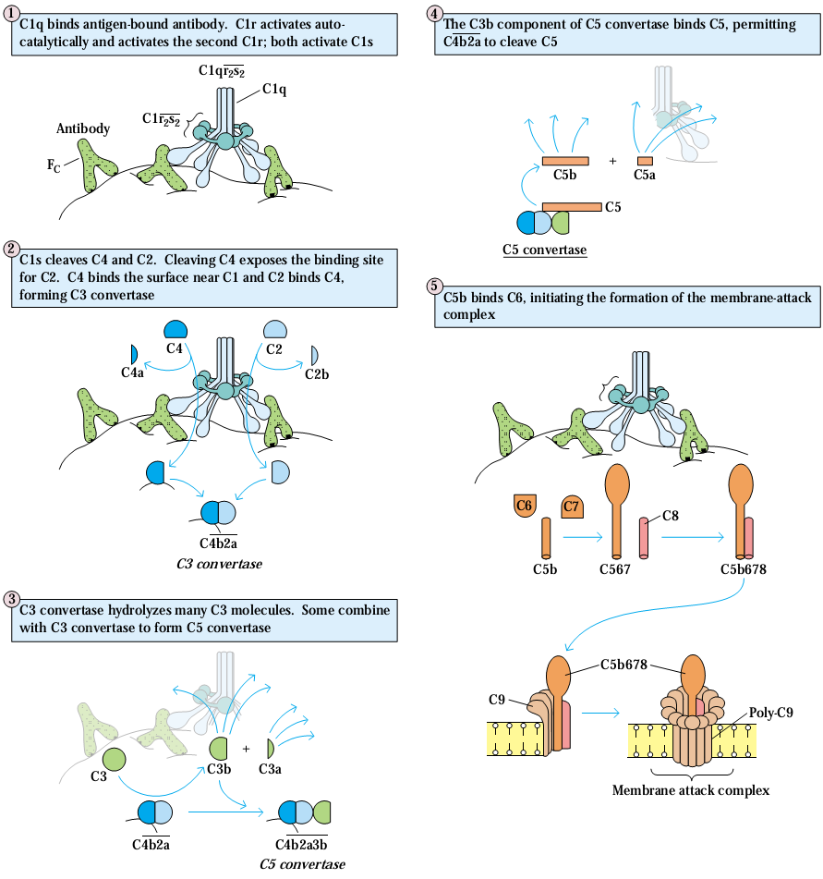

Slide 23
III. The Alternative Pathway: Ab independent
C3, factor B, factor D, & properdin
Cell-surface constituents (gram -ve & +ve)
C3 hydrolysis => C3a & C3b

Slide 24
C3b => foreign surface Ag or to host’s own cells Factor B = form a complex (C3bFactor B) => factor D
 Factor D  C3b-bound factor B => factor Ba (mic.envn’t)
C3bBb => C3 convertase
Properdin binds to C3 convertase & stabilizes it

Slide 25
Conti… The Alternative Pathway
C3bBb activate un-hydrolyzed C3 => C3b ☑ C3bBb3b (C3bBbC3b) complex = C5 convertase  end of alternative pathway
C5 => C5a & C5b
☑ C5b binds to the Ag surface
Alternative Pathway
Non-specific resistance against infection (without Abs)
Provides first line of defense

Slide 26
Amplification loop of C3b formation
Low level spontaneous hydrolysis of C3 => C3i
Factor B binds to C3i & susceptible to Factor D Factor B => Bb
C3iBb = C3 convertase  C3 => C3a & C3b

Slide 27
Factor B bind to C3b & susceptible to cleavage by Factor D
 C3bBb = C3 convertase ---> C3b = amplifying C3b prodc’n
If unchecked => consumption of all C3
 C3 deficiency & ↑ susceptibility to certain infections

Slide 28
Regulation of the amplification loop
As spontaneously produced C3b binds to host membranes
DAF (decay accelerating factor)
Blocks association of Factor B (C3b) - No C3 convertase
Dissociation of Bb from C3b in C3 convertase stops prod’n C3b

Slide 29
Cells with complement receptor 1 (CR1) bind to C3b
Enzymatic degradation of C3b by Factor I
C3 convertase (C3bBb) bind to CR1 =>dissociates Bb (complex)
Factor H bind to C3b => enzymatic degradation of C3b by Factor I

Slide 30
Controlled => blocking the formation of C3 convertase, => Dissociating C3 convertase, or => Enzymatically digesting C3b

Slide 31
IV. Membrane attack (Lytic) Pathway  Lyse bacteria, parasites, viruses, erythrocytes, & nucleated
The C5 convertase - classical (C4b2a3b), lectin (C4b2a3b) or alternative (C3bBb3b) C5 => C5a & C5b
C5b associates with C6 & C7 & inserts into the membrane

Slide 32
 Binding of C8 then C9 Form pore in the membrane => the cellular contents leak & lysis occurs
 not enzymatic process - physical damage on membrane
 C5bC6C7C8C9 = membrane attack complex (MAC)

Slide 33
Hypersensitivity (allergy)
Excessive, undesirable (damaging, discomfort & fatal) rxns
inappropriate and/or heightened IR  ↑ed response to the Ag
= Tissue damage (Inflammatory response)

Slide 34
Humoral or cell-mediated responses
Pre-sensitized (immune) state or re-exposure to an Ag
Four types: type I, II, III & IV
 Mechanisms involved & time taken

