Slide 1
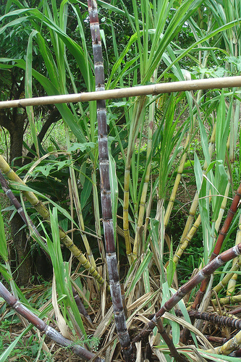
Industrial Crops Production (Plsc 2063)
By Nuru Seid
(M.Sc. in Agronomy)

Slide 2
Chapter Two: Sugar Producing Crops
Sugar and starch crops - Crops grown for production of sugar and starch. e.g., sugarcane, sugar beet, potato, sweet potato, tapioca and asparagus.
Sugar can be produced from:
sugarcane
sugar beet
few palms or palm trees and
sweet sorghum
However, sugarcane & sugar beet account are the main source of sugar, almost 100% of sugar production in the world.
Also, the utilization of sugarcane has expanded from being mainly for sugar to biofuel and a host of co-products.
Notes:
Clones –replica, duplicates, twins
Propagation- broadcast, dissemination, spreading, breeding mosaic- mixture or assortment disease

Slide 3
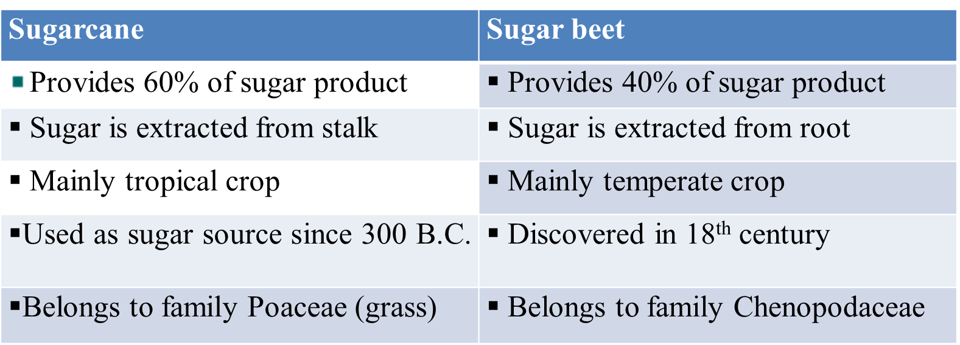
Comparison of sugarcane and sugar beet
Notes:
Commerce – business or trade (export and import)
Commodity – product, service or goods

Slide 4
Comparison Cont…
Both sugar beets and sugar cane produces sugar, the similarities between the two crops end there.
They prefer different climates, with sugar cane favoring year-round warmth, while sugar beets favor much cooler conditions.
The two crops also have different plant physiologies:
Sugar cane is a C4 crop, and the sugar is stored in the stalk
while sugar beets are C3, and the sugar is stored in the roots.
The two sugar crops together take up slightly more than 2% of the cultivated croplands in the world.
Notes:
Decortications – removal of surface layer
Prospect – outlook or view

Slide 5
Comparison Cont.…
Major/largely cultivating areas of sugar beets are the temperate latitudes of the Northern Hemisphere from 40°N to 60°N, mostly in Europe and the European part of Russia, while
Sugar cane is a tropical crop, cultivated mostly in the Caribbean and Florida, but also in Central and South America, India, and other parts of south Asia.
Minor/less cultivating areas of sugar beets are the American Midwest and the northeastern tip of China, while sugar cane is also grown in Australia and South Africa.
Notes:
Curing – remedial, curative, medicinal
New Guinea- country in Western Africa and its Official name is Republic of Guionea

Slide 6
2.1. History, Origin and Production of Sugarcane
Modern sugar cane production began when the noble cane S. officinarum originated in New Guinea, and spread to India & China
By the end of 12th century, the crop had spread throughout the world, with changes from mainly small scale farming to cultivation on large estates
Today, it’s the strategic sector in many developing economies where agricultural activities provide best labor absorption in rural areas
In recent history, the largest expansion in sugar in sugar production occurred in b/n the 1965 and 2010 with countries such as India (3 to 30 Mt and Brazil (5 to 40 Mt) of sugar dominating global production

Slide 7
Cont…
Worldwide, sugar production in 2010-2011 was 168 million tones, 7.4 million tons higher than in 2009-2010.
The main driver for this expansion is increased world sugar consumption resulting from rising incomes and changes in food consumption, particularly in Asia and Africa
This estimation reflects an expected increase in sugar production in both Brazil and India that together account for around 40% of world sugar production
Notes:
Labor absorption – assimilation or incorporation; It’s believed that the sugar cane is originated in south pacific probably in New Guinea

Slide 8
Table 1. World’s 10 Largest Sugar-producing Nations
Rank |  | Country | Production in millions of metric tons
1. |  | India | 38.745
2. |  | Brazil | 26.000
3. |  | China | 11.475
4. |  | Thailand | 10.061
5. |  | U.S.A. | 7.210
6. |  | Mexico | 5.495
7. |  | Pakistan | 4.400
8. |  | France | 4.275
9. |  | Australia | 3.800
10. |  | Germany | 3.565

Slide 9
2.2. Botany of Sugarcane
Sugarcane belongs to:
Family- Poaceae (Gramineae)
Genus -Saccharum
The genus Saccharum consists 6-speicies cultivars of which 4 are domesticated and 2 are wild species.
S. officinarum L.
S. sinense Roxb
S. barberi Jesw.
S. edule Hassk.
S. spontaneum L. and
S. robustum Brandes and Jeswiet
Notes:
Wild species- undomesticated, uncultivated, natural or in their natural habitats

Slide 10
A. Cultivated Species
Commercially produced cultivars are usually interspecific hybrids, primarily of S. officinarum and S. spontaneum, but also of all other Saccharum species except S. edule, since it is infertile or unproductive.
S. officinarum (noble cane) originates from the South Islands of India and known as noble canes because of
It is only suited to tropical conditions and described by
It’s thick stems, high quality of juice
high sucrose content with low fiber
3-5 meters in height with few tillers
most suited to tropical conditions
largely grown in world as well as in Ethiopia.
but, susceptible to most of the major sugarcane diseases
Notes:
Interspecific hybrids: created from different species
Commercially – for profitable or saleable, marketable, money- making or profit making or business

Slide 11
Cont.…
S. edule: chracterized by
appears to be restricted to Malaysia & Indonesia - indigenous
considered to be a mutant of S. officinarum
Unusual/abnormal,swollen and aborted inflorescence – sterile/infertile
S. barberi: is containing a series of hybrid and is mainly found in India and has its own distinct characteristics:
suited to sub-tropical and temperate climate
Canes/stalks are short, medium to slender /slight in thickness
high fiber content and poor yields
tillers abundantly/plentifully
b/s of its poor yield it is no longer cultivated
Notes:
Mutation/mutant: changing of genetic material-transformed or changed

Slide 12
Cont.….
S. sinense: another hybrid, is indigenous to Indo-China
Clines are tall, hardy & vigorous and characterized by
wide adaptation and resistant to mosaic diseases, but more susceptible to insect pests
early maturity, high fiber content and poor juice quality
It is thought to be obtained from natural hybrid of S. spontaneum and S. officinarum

Slide 13
B. Wild species
S. spontaneum: a perennial grass & free-tillering occurring in wild form in Africa & Asia .
Used in hybridization as it provides vigor, hardiness and resistance to most of the major diseases.
it is still used for breeding commercial hybrids
Natural hybridization with S. officinarum has produced S. barberi and S. sinense
S. robustum: is another wild species native to New Guinea often reaching 10m in height, which is used for house and fence.
It is restricted to New Guinea and neighboring Islands,
It has hard stems, woody, condensed in center with little juice
Its use for breeding is limited because of its complete susceptibility to diseases

Slide 14
Cont.…
Nowadays almost all commercial varieties of sugarcane are hybrids, derived from breeding between the species of commercial importance
Thus, from crossing programs, the modern hybrid Sugarcane variety incorporates the vigor & hardiness of S. spontaneum & S. sinense coupled with the higher sugar content of S. officinarum & S. barberi
S. spontaneum X S. officinarum
(Vigor, hardiness, resistance) (sucrose yield)
Hybrid - commercial varieties

Slide 15
2.3. Morphology of Sugarcane
Morphologically sugarcane is similar to that of maize (Zea mays L.) and sorghum (Sorghum bicolor L.).
Length, diameter, shape and color of the cane vary with the cultivars and used as a means of identifying the different cultivars.
The most commonly known colors of canes are yellowish green & purple.
Stem is the economically important part of sugarcane
It is called cane, stalk or Culm
It consists nodes, leaf sheaths and internodes, that form the bulk of the sucrose storage tissue.
At harvest, a single stem can produce 20-30 internodes which have 10-20cm, long based on climate & nutrition.
In sugarcane the stem vary in length from 1.5-4 m, typically 2-3m and 2-4cm diameter is common.
Notes:
Purple: a dark color that is formed as a pigment by combining red and blue sec-2
Sheaths: case for blade
Morphology – a description structure of form of some thing

Slide 16
Cont.…
Top portion of the stem is low in sucrose content and is usually removed before processing.
Tops and trash uses for soil conservation - OM
There is great variation in sugar accumulation among genotypes within the Saccharum complex.
Concentration of total soluble solids in juice range from 0.2% in a S. robustum clone to 24.5% in S. officinarum clone.
Commercial cultivars are capable of accumulating sucrose concentrations to 27% of juice in the storage tissues
Notes:
Commercial variety-profitable, marketable or saleble

Slide 17
Cont.….
Roots: The root system of sugarcane is mostly fibrous and concentrated in the top 30 to 60 cm of soil that serve to anchor the plant. Shallow root system
Sugarcane produces mainly 2-types of roots:
Young cane plant showing two kinds of roots
Sett roots from the root primordia of the cutting And
Shoot roots originating from the root primordia of the shoots
Sett roots:- thin branched temporary roots developed from sets until 3 months after emergence.
Shoot roots:- permanent roots developed after three month from emergence And
Provide all the nutrients & moisture as well as physical support to the plant.
Leaves:- sugarcane is a C4 plant with alternate leaves, 1-2 m long and 5-7 cm wide
Notes:
Fibrous: consists of numerous very fine branches of roots approximately the same length
Anchor- secure, fasten or attach and fix

Slide 18
Cont.….
It has leaf blade/lamena, expanded portion, 2-10cm wide and 60-180cm long and the sheath with a ligule separating the two parts and also used as a distinguishing characteristic between cultivars.
A good crop of sugarcane at full growth stage have a leaf area of 10 times greater than the area of soil on which the crop is grown (LAI=10).
As the leaf die, the sheaths may become loose and break away easily at the point of attachment known as “free-trashing”.
Like maize, sugarcane uses the C₄ pathway of photosynthesis.
Produce four carbon acids (oxaloacetic acid or malic acid) as primary product of carboxylation reaction – carbon fixation
Species having this pathway referred to as C-4 species
The four-carbon organic acid, oxaloacetic acid is the first product of CO₂ fixation in the mesophyll cells.
Notes:
Ligule: an outgrowth at the junction of the leaf sheath and leaf blade in a grasses

Slide 19
Cont.…
Inflorescence:
At maturity the cane changes from vegetative to reproductive stage
Cane has to reach a certain physiological stage of development before flower initiation can take place
It is also known as arrow or tassel and consists of a branched panicle with a vertical axis
Flowering signifies the change from the vegetative to the reproductive phase
When flowering occurs, no further leaves and internodes are produced on the flowered stalk
b/c once the young developing internodes below the flower have fully expanded, growth of the stalk ceases
Flowering is an undesirable character as it results in loss of sugar, which is used up in the process.
It also terminates further internode development and increases fiber content.
The flower is protogynous (the stigma is receptive before the pollen is shed) and is naturally pollinated by wind.
Flowering is detrimental to sucrose yield because flowering stalks use up sucrose and therefore, deteriorate the quality of cane
As the production of the inflorescence also reduces the sucrose content of the stem, efforts are often made to delay flowering so as to maintain sucrose yield
Notes:
Protogynous: maturation of female reproductive organ of flower Sec-1

Slide 20
Cont.…
The flowers rarely set seeds and even if set the seeds soon loose viability with in only a few hours but modern freeze-drying technique permit storage and transport between countries for breeding purpose
As the production of flowers reduces the sucrose content of the stem, efforts are often made to delay flowering by:
adjusting temperature: <18⁰c hinders flowering;18-24⁰c – optimum for flowering
adjusting light: it is a short day plant (that flowers in short day: < 12 ½ hrs of light) therefore, > 12½ hrs of light hinders flowering.
Thus, exposing the fields to light at night for half an hour's will hinder flowering.
Notes:
Hinder- get back or delay

Slide 21
Cont…
True seed (fuzz used only for breeding) germinates under certain conditions to produce roots and shoots, and seedling is effectively a potential new cultivar
Propagation:- sugarcane is propagated vegetativelly usually from setts (pieces of stalk ) which can be planted as single setts.
These pieces of stalks should be Three-budded or “three-eyed” setts or full stalk, which is the cut into setts in the furrow
More recently, tissue culture (plantlets or sprouts) are being used to propagate sugarcane
Tissue culture provides disease free seedcane to projects or estate farms for quick multiplication of elite cultivars
Well grown, healthy setts from 9 to 10 month old cane provided with adequate nutrition are an ideal source seedcane
Buds at the top of the stalk tend to germinate faster than buds arising from the more mature lower parts of the stalk.
Notes:
Elite – selective or best or influential or clean seedcane
Tissue culture – produced by specialist nurseries to provide materials

Slide 22
2.4. Ecological Requirement of Sugarcane
Sugarcane is a warm temperate and tropical or subtropical which requires warm, sunny and moist climate and well fertile , deep and well aerated soils
The crop cycle, growth and maturity are largely influenced by climatic conditions (moisture and temperature favour growth
while dry sunny, cool periods and low temperature are favorable for maturation or sugar accumulation – suitable for ripening of cane
It is sensitive to frost and flood or overflow
The variety or cultivars of cane require a particular agro-ecology – specific agro ecology, For instance
Saccharum robustum grows along river banks or basins
S. spontaneum extends mainly in warm temperature regions and have the ability to tolerate a much wide range of conditions

Slide 23
Cont..
S. officinarum is essentially to tropical, while s. barbari and s. sinense are mainly grown in sub tropical and temperate regions
Climate – temperature
S. cane requires plenty of temperature and sunlight for growth with optimum tem. Of 25-30 ^{O}C
It is highly responsive to high tem or solar radiation and water
Tem have positive effect on sugar accumulation, b/c solar radiation drives or determine photosynthesis- important for cane growth- potential yield of cane
So, cane plant is one of the most efficient converter of sunlight into chemical energy stored in sugar, fiber and straw
Notes:
Chemical substrate or compound or element

Slide 24
Cont…
Rainfall/moisture
Large quantity of water with at least 1525 mm rain per annum, unless growth with irrigation supply is necessary
Three processes characterized the movement of water through the cane plant
Absorption of water from the soil through the root system
Transportation of water and nutrients in the plant and
Loss of water through transpiration through the leaf stomata to the atm.
Notes:
Xylem –upward and phloem –downward ; annum- year

Slide 25
Cont…
Soil
Soils help to enable deep root and provide dynamic nutrient cycling
Sugarcane can be grown in a wide range of soil types, but heavy soils (loam to clay loam soil) are usually preferred .
The crop is a heavy feeder and soils should be of high natural fertility or given adequate fertilizer.
The optimum soil pH for sugarcane is 6.5
Generally, the soil should be: deep fertile, well aggregated with optimum pH of 6.5, uniformly textured heavy (loam to clay loan) soils

Slide 26
2.5. Sugarcane Production in Ethiopia
Sugarcane was introduced to Ethiopia in 19th century, in 1951, by the agreement signed between Ethiopian government and Dutch company, HVA (Handlers -Vereenging Amsterdam).
Then the following factories/sugarcane estate/ were established:
Wonji in 1954
Shoa in 1962
Metahara in 1969
Fincha in 1998.
The development of the sugarcane plantation was started on 5,000 hectares in the upper reaches of the Awash basin.
Notes:
Reach – arrive at, get to attain

Slide 27
Cont….
Sugar production in Ethiopia started in 1954/55 when the Wonji Sugar factory was commissioned and produced 15,843 tons of white sugar in the first campaign.
Currently, there are three large-scale sugar establishments in the country; two of them in the Awash Basin (Wonji/Shewa and Metehara) and one (Finchaa) in the Blue Nile Basin.
The present level of national production from the three-sugar estates is about 261,041 tons of sugar and 87,257 tons of molasses, per annum, respectively.
Notes:
Basin: land draining into river or lake; a broad area of land drained by a single river and its tributaries.
Campaign – movement, operation; commission- make to order, specially made

Slide 28
Cont….
These three sugar factories have a production capacity of 280,000 tons of sugar annually.
The total area developed by these factories is 23,769 hectares.
The area developed at Wonji/Shewa is 7050 hectares (5930 hectares estate and 1120 hectares out grower farms) capable of producing 80,000 tons of sugar per annum.
The Metehara Sugar Factory, which was brought on stream in 1969 by HVA at Metehara, developed 9919 hectares and has a capacity to process 115,000 tons of sugar annually.
The Finchaa Sugar Factory (in East Wellega) which was completed in 1998, developed 6800 hectares and has a production capacity of 85,000 tons of sugar per annum.

Slide 29
Cont…
At present, there are additional three sugar plantations are developing by the government.
Tana beles sugar project is developing in 50,000 hectares with a production capacity 484,000 tons.
Kuraz sugar project is developing in 150,000 hectares with a production capacity of 556,000 tons.
Wolkayit sugar project is developing in 25,000 hectares with a production capacity of 242,000 tons.
Totally the three estates potential is 225,000 hectares with production capacity of 1,282,000 tons of sugar/annum.
Currently, new 303,500 hectares of land also already identified suitable net areas for sugar estate farms in 7 sites.

Slide 30
Cont…
The annual consumption of sugar in Ethiopia is estimated at 5.4 kg/head/year.
This is considered low even by African standards, which is estimated to be 20 kg/person/year.
Ethiopia still needs to produce an additional 80,000 metric tons per year to satisfy the current total demand of sugar consumption in the country.
Consumption:
5.4 kg/head/year (Ethiopia)
60 kg/head/year (Ireland)
54 kg/head/year (Netherlands) and
52 kg/head/year (Australia)
Notes:
Metric ton: a unit of weight equal to 1,000 kg.

Slide 31
2.6. Sugarcane Production Practices
Sugarcane is grown mainly in the tropics and subtropics
Sugar cane agronomy involves the irrigation of soil sciences and crop production
The ideal environment for sugar cane is one in which rain fall (irrigation) is well distributed during the growing season
Sugar is stored in the stalks but conditions favorable for ripening are necessary if sugar production is to become economic (pre-harvest ripening period should be relatively dry)
Because, Ripening normally take place during the cooler and drier times of the year
Where the crop is produced under irrigation, this can be induced by a reduction in the water supply-limiting water supply
Notes:
Sugarcane Agronomy; thrive well – grow well
But where the pre-harvest ripening period should be relatively dry, and the sunshine hours are plentiful through out the whole season

Slide 32
Sugarcane Agronomy
Sugarcane production practices are influenced by many factors including
Climate, landform, soil composition and structure, irrigation, varieties, pest and disease management and labour skill availability
Planting is generally considered as one of the major field practices that deserve special attention, as it is the corner stone for good initial establishment of cane in fields.
Generally, the key field operations in sugar estate/production are grouped as:
pre-planting operations
planting and
post-planting activities.
Notes:
Furrow: trench in plowed field; a narrow trench in soil made by a plow

Slide 33
Cont…
Pre-planting field operations:
Sugarcane plantation site should be located near a Mill and boiling house
The site should be gentle to moderate slope, suitable soils with ample/sufficient irrigation potential
Soil type, slope and drainage are factors that are important to site selection
Rain fall records and surveys for quality of potential irrigation water are essential in preparing a plan for sugar project developments
Notes:
Site selection

Slide 34
Cont..
Land clearing may have to be done if it is not in cultivation
land preparation
Once the site has been cleared and previous vegetation cover removed, it must be prepared for planting
Tillage/ploughing is the process by which mechanical or manual manipulating of soil to incorporate the soil particle with soil OM
the objective of this operation is to cultivate the soil to depth in order to break any soil pans that occurs as a result of compaction and to mix the top soil
Following the subsoil/subsurface, the field should be harrowed to brake clods and improve or produce good surface tilth to get fine seedbed
Notes:
Clearing – removing of vegetations cover; manipulate- operate or work

Slide 35
Cont…
Principal objectives of land preparation
To destroy the previous crop
To remove roots and stones to improve harvesting condition and volunteer re-growth plants which may transmit smut and ratoon stunting disease (RSD) to the next crop
To break up existing plough pans or clods resulted as soil compaction
To install suitable surface and subsurface drainage and field layouts
To provide/produce an adequate surface tilth for germination and growth of sugarcane crop
To make planting furrows 1.5 m apart

Slide 36
Cont...
Pre-planting Irrigation
This field practice (light irrigation) is performed by surface, drip and sprinkler irrigation systems and has the following advantages:
Help to check any irregularity in furrow depth and its suitability for irrigation water conveyance or delivery.
Create favorable condition for smut spores in the soil to germinate.
Ensure availability of adequate soil moisture for cane bud germination since sugarcane is one of the heaviest user of water after rice perhaps use more
This water demand is received either as rainfall or applied as irrigation, or combination of both i.e. reliable water distribution/pattern to meet demand of crop
So, full and proper irrigation is required to sustain the crop demand for growth
Notes:
Smut spores: fungus causing disease; a parasitic fungus that causes smut. Conveyance – transportation or passage

Slide 37
Cont…
Sugar cane water demand
crop water requirements (CWR) refer to the amount of water required to raise a successful crop with optimum yield in a given period or season
In another words crop water requirement is defined as “the depth of water needed to meet the water loss through evapotranspiration of a disease- free crop growing in large fields under no- restricted conditions- including soil water and fertility and aimed at achieving full production potential of crops. It comprises
the water lost as evaporation from the crop field
water transpired and metabolically used by crop plants
water lost during application/irrigation which is economically unavoidable, but can be reduced to some extent (seepage, excess surfac runoff, leaching /deep percolation etc – loss factors )

Slide 38
Cont…
The crop water requirement (CWR), equivalent to ETc, is defined as water lost from a crop through evapotranspiration (Eto) and is derived from the effect of climate and crop specific characteristics.
Climatic effects are estimated using Eto and crop characteristics by the crop coefficient (kc) crop coefficient from reference crop based on “Pan man determination” which is a technique available to estimate ETc
crop water requirements are normally expressed by the rate of evapotranspiration (ETc) in mm/day or mm/period and this may be formulated mathematically as: ETc = kc x Eto
Notes:
Comprise – embrace- cosmists of – encompass- involve

Slide 39
Cont…
Crop yield is strongly correlated to evapotranspiration (Eto) and Etc is the principal factor in irrigation planning and scheduling program
Because, CWR is the starting point to determine the capacity of an irrigation scheme
Irrigation water requirement (IWR) or IR
It is important to make a distinction between crop water requirement (CWR) and irrigation requirement (IR)
Crop water requirement is the amount of water required to compensate the evapotranspiration loss from the cropped field either from RF or Irrigation supply
Notes:
These range from evaporation pans to climate based simulation models.

Slide 40
Cont…
If the crop receives some of its water from other sources (rainfall, water stored in the soil, underground seepage, etc.), then the irrigation requirement can be considerably less than the crop water requirement
Irrigation water requirement is the water that must be supplied through the irrigation system to ensure that the crop receives its full crop water requirement.
If irrigation is the sole source of water supply for the plant, then the irrigation requirement will be equal to the crop water requirement (IR = CWR)

Slide 41
Cont…
Importance of estimating irrigation requirements
Estimating the crop water and irrigation requirements for a proposed cropping pattern is an essential part of the planning and design of an irrigation system.
The irrigation requirement (IR) is one of the principal parameters for the planning, design and operation of irrigation and water resources systems.
Methods of irrigation
An adequate water supply is important for plant growth. So, when rainfall is not sufficient, the plants must receive additional water from irrigation
Proper irrigation water management aims at optimum and efficient use of water for best possible crop production keeping water losses to the minimum level
Water is applied to the soil surface by a number of various irrigation methods
Notes:
Planning- set up- preparation- schedule - development

Slide 42
Cont…
1. surface irrigation method
Surface irrigation is the application of water by gravity flow to the surface of the field.
Either the entire field is flooded (basin irrigation) or the water is fed into small channels (furrows) or strips of land (borders)
Typical elements of a surface irrigation system
Basin irrigation
Border Irrigation
Furrow irrigation:- Furrows are small channels, which carry water down the land slope between the crop rows
furrow irrigation of sugarcane is popular for several reasons
Notes:
Popular-acceptable, fashionable, trendy, in style

Slide 43
Cont…
water is applied through/by gravity with out the need of power
Wind has no effect on application efficiency – indicator of irrigation performance
It is simple and cheap system to install and operate – simple to deliver water
It can be adapted to wide range of soil type and topography
This method is suitable for all row crops and for crops that cannot stand in water for long periods – crops those susceptible to water logging
Water infiltrates into the soil as it moves along the slope.
The crop is usually grown on the ridges between the furrows
Irrigation water flows from the field channel into the furrows by opening up the bank of the channel, or by means of siphons or spills
Notes:
When to use Furrow irrigation? it is suitable for a wide range of crops, slopes and soil types. Furrow irrigation is suitable for many crops, especially row crops

Slide 44
Cont…
2. Drip irrigation
Drip irrigation systems are a form of pressurized system in which water is applied in small, controlled quantities near or below ground level
With drip irrigation, water is conveyed under pressure through a pipe system to the fields, where it drips slowly onto the soil through emitters or drippers which are located close to the plants.
Only the immediate root zone of each plant is wetted
Therefore, this can be a very efficient method of irrigation – less water losses
Drip irrigation system is most commonly used for production of vegetables and perennial crops, although some limited commercial applications are occurring with certain row and field crops
Notes:
Drip irrigation is used for areas where lack or shortage of rain fall distribution to – to use economically – no losses

Slide 45
Cont…
3. Sprinkler irrigation
Sprinkler irrigation is a method of applying irrigation water which is similar to natural rainfall.
Water is distributed through a system of pipes usually by pumping or pushing siphons
It is then sprayed into the air through sprinklers so that it breaks up into small water drops which fall to the ground.
The pump supply system, sprinklers and operating conditions must be designed to enable a uniform application of water.
Sprinkler irrigation has been adopted in many areas as a water-conserving alternative to gravity-flow systems.
Notes:
Pump

Slide 46
Cont…
Planting Material Preparation
Profitable crop production partly depends on the quality of the seed used for planting.
The quality of seedcane used in planting is fundamental to the production of high yielding, healthy plant cane and that of subsequent ratoons
Quality is determined by the freedom from diseases and pests, varietal purity and germination ability
Many diseases are transmitted through infected seedcane (smut, RSD, mosaic infection , yellow leaf syndrome (YLS), leaf scald etc) and many of them can cause sever yield losses
So, the potential cane yield that should be obtained will not be achieved if seed cane of poor quality is planted.

Slide 47
Cont…
Varietal purity ensures that the desired variety is grown and the seedcane is not contaminated with unwanted varieties susceptible to diseases
Young, well-grow, seedcane is more vigorous than old cane, and germinate better giving early, rapid establishment and uniform growth
All these requirements can only be satisfied by seedcane produced in managed nurseries, and not from commercial fields
The seedcane nursery should preferable be isolated from other sugarcane producing farms on a good soils
Seedcane should be 8-10 months old for optimum vigor and establishment when planted commercially in warm regions
The size of nursery depends on the expected yield of seedcane, the extent of area to be re-planted and the rate of seedcane in tonnes/hectare to be planted commercially
Notes:
The management provide for nursery is not equal to commercial field

Slide 48
Cont…
Seed cane quality is measured by:
Freedom from diseases and pests
Varietal purity or free from off types and
Germination capacity.
Therefore, the selection of quality planting material is of high importance, and requires the most careful attention.
Seedcane for commercial plantation should be young plant cane from defined nurseries and virtually free from pests and diseases
Generally, a seed cane free from diseases, having healthy and vigorous buds is the base for a good commercial crop.
Seed setts/canes are usually prepared by laborers working on the interval at the side of a field to be planted.
Alternatively, this work may be done at some central point, from which the setts are distributed to the fields.
Notes:
Varietal purity: pre-form any contaminants.

Slide 49
Cont…
The cane is chopped on a wooden block, using a cane knife and the top soft parts of the stalk and the old/hardened bottom parts should be discarded since their germination is negligible.
Requirements for Quality Planting Material
A seed material obtained from 8-10 months crop age is used
Seed material should be obtained from a well fertilized and irrigated crop
It should have more than 95% of viable healthy buds.
Moisture content of the setts should be more than 70%.
It should be free from incidence of diseases and insect pests.
It should be from hot water treated cane stalks.

Slide 50
Cont…
Seed Material Preparation Procedures
Seed Cane (SC)
The seed material should be around 8-10 months crop age.
Chopping is done after leaf sheath is removed in order to facilitate bud germination
Length of cane setts chopped is 20-30cm.
Distance of chopped setts between node and end should be around 5 cm with at least 2 - internodes .
Setts should be Benlate (Benomyl) treated/ chemical treatment or HWT.
Lysol solution is used to disinfect chopping cane materials /knives.
An average seed cane material consumption per ha ranges from 0.8 to l ton (8 to 10 quintals) of setts

Slide 51
Cont…
Seed cane Treatment Practices
HWT (50ºC for 2 hours ) is used to get a seeds free from diseases such as:
smut
ratoon stunting disease (RSD)
leaf scald, mosaic infection
chlorotic streak, etc. which can cause serious yield losses.
Planting/propagation
Sugarcane is propagated by stem cutting of immature canes which contain viable bud.
A seed cane is from 25-30 cm long and contains at least 2 bud, but it is preferable to have from 2-3 buds.
Planting is done by laying a set of two buds about 20-30 cm lengths in the furrow.

Slide 52
Cont…
Time of planting
In Ethiopia, it is mainly planted in five months i.e. mid-December - May.
The early planting has favored the growth of cane and ultimately resulted high yields.
Late planted crop is likely to suffer more due to water logging at younger stage.
Furrow planting
In general, furrow method of planting is used, the depth of planting is about 20-30 cm with depth of soil covering varies from 2-8 cm.
All sugarcane varieties are planted in an overlap of 5 cm except long internodes (20-25 cm) varieties, that need to be planted at 10 cm overlap, keeping the bud sideward.
Notes:
Overlap: place or be placed over; the edge of one thing is on top of and extending past the edge of another.

Slide 53
Cont…
Plant Density-seed rate
Planting density is sometimes used to denote the number of setts or seed pieces planted per hectare.
This is determined by the distance between row centers and spacing of the setts in the row.
Seed rate of sugarcane setts vary due to a number of factors such as:
Variety
Row distance
Planting method
Sett placement, and
Number of buds per sett.

Slide 54
Cont…
Planting pattern: Generally three types are used:
Single line planting: only a single seed piece is put on a point at spacing of 1.5 m (between furrows) x 0.6 m (between seed canes) and used when the environmental conditions are favorable for germination and for varieties with high germination rate.
Double line planting: two seed pieces are put at a spacing of 1.5m between rows & 0.6 m between plants to ensure good germination rate and used when the environmental conditions are not favorable for germination and for varieties with poor germination.
Single line planting with edges of the seed canes overlapping by 10 to 15 cm. This is the common planting pattern used in Ethiopia.
Germination occurs from 10-12 days after planting
The crop cycle of sugarcane is from planting to harvesting of the last ratoon crop. Thus, it includes plant crop + 3-4 stages of ratoon crop.
Notes:
Stages-phases, periods or steps

Slide 55
Cont…
Filling gaps/open spaces
Gaps/open spaces sometimes occurs due to uncontrollable factors such as climatic condition coupled with particular inherent problem of fields that bring about unsuccessful germination.
Open spaces exceeding 30 cm in length to be commonly observed two months after planting is usually filled with healthy setts or sprouts.
Stand Establishment – ratoon crop management
Sugarcane is a perennial crop and allows re-growing from vegetative buds on the crown after the crop has been harvested.
Regrowth of the sugarcane field is called ratooning.
In most cultivars the plant cane and first ratoon crops tend to have the highest yields.
Stalk population and size are decreased with each successive harvest, and the plant will finally be destroyed and replanted.
Notes:
Milling: riged edge

Slide 56
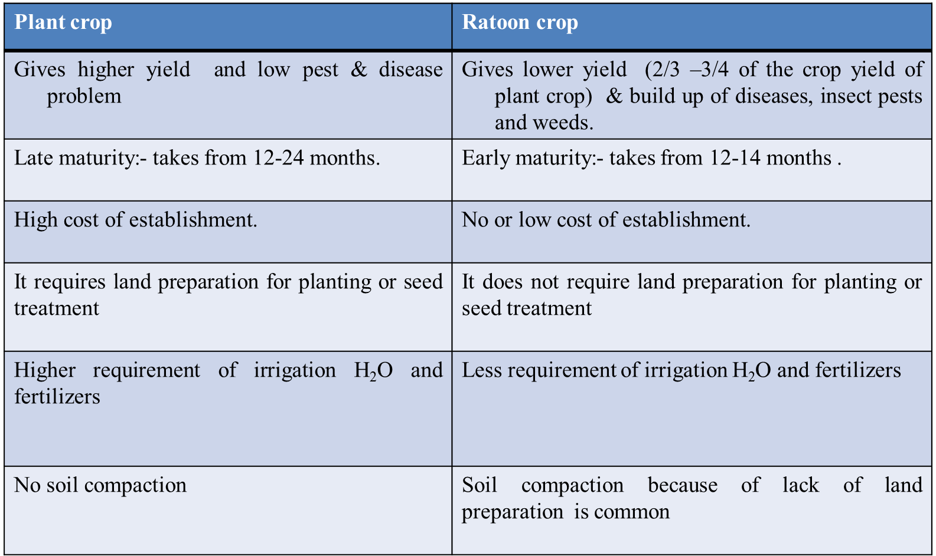
Comparison of Plant Crop and Ratoon Crop
Notes:
Ratoon: a shoot growing up from the base of a crop plant after the previous growth has been cut back

