Slide 1
CHAPTER THREE
Field Surveying Techniques
Classification of stratigraphic units is the categorization of stratigraphic units based on the properties that the unit reflects in the stratigraphic sequence.
Nomenclature of stratigraphic units indicates the assigning specific name for each of the unit with in the stratigraphic sequence.
1. Bed: is the smallest recognized rock- stratigraphic unit. It is the smallest formal lithostratigraphic unit.
2. Member: is a distinctive bed or set of beds within a formation.

Slide 2
3. Formation: Is a stratigraphic unit with homogeneous litho logical characteristics .
A particular rock unit must meet at least two criteria for a geologist to term it a formation:
a) It must be widespread and thick enough to be mappable
b) It must be readily distinguishable from adjacent units
4. Group: is the assemblage of different formations.
5. Supergroup: a formal assemblage of related or superposed groups.

Slide 3
Classification of stratigraphic units
Lithostratigraphic units (lithology).
Biostratigraphy units (fossils).
Chronostratigraphic units (time).
Magneto stratigraphic units (magnetic).
Chemo stratigraphic units (chemical).
Seismo stratigraphic units (seismic).

Slide 4
3.2 FIELD MAPPING OF SEDIMENTARY ROCK :
For the identification of sedimentary rock types in the field, the two principal features to note are:
Composition–mineralogy and
Grain-size.
On the basis of origin, sedimentary rocks can be grouped broadly into two major categories:
Clastic
Non clastic (Chemical, Biochemical and biogenic).

Slide 5
Indicatorsfor the origin of sedimentary rocks:
The presence of stratification.
The presencce of specific minerals (e.g., glauconite, chamosite).
The presence of sedimentary structures.
The presence of fossils.
The presence of different grains size.
Clastic sedimentary rocks:- Is the result of the accumulations of
terrigenous clastic.
The most common clastic sedimentary rocks are:
Conglomerate, breccias, Sandstone, Mud rock, Shale, Siltstone, Marl & Clay stone.

Slide 6
Name of Particle | Size Range | Loose Sediment | Consolidated Rock
Boulder | >256 mm | Gravel | Conglomerate or Breccia (depends on rounding)
Cobble | 64 - 256 mm
Pebble | 4 - 64 mm
Granule | 2 - 4 mm
Very Coarse Sand | 1 - 2 mm | Sand | Sandstone
Coarse Sand | 0.5 - 1 mm
Medium Sand | 0.25 - 0.5 mm
Fine Sand | 0.125 - 0.25 mm
Very Fine Sand | 0.0625 - 0.125 mm
Coarse Silt | 0.031 - 0.625 mm | Silt | Siltstone
Medium Silt | 0.016 - 0.031 mm
Fine Silt | 0.008 - 0.016 mm
Very Fine Silt | 0.004 - 0.008 mm
Clay | <0.004 mm | Clay | Claystone, Mudstone, Shale

Slide 7
CLASTIC (detrital) sedimentary rocks based on grain size:
Argillaceous rocks
Arenaceous rocks
Rudaceous rocks
Argillaceous rocks: It is the composed of clay size and silt size particle. The most common Argillaceous rocks are:- mud rock, shale, siltstone, clay stone, marl.
Arenaceous rocks:-it is the composed of sand size particles. The most common arenaceous rocks are sandstones.
Types of sandstones
Quartz arenites =dominated by quartz grains.
Arkose =dominated by feldspar grains.

Slide 8
3) Lithic arenite=dominated by rock fragments
4) Greywacke are mostly hard, light to dark grey rocks with abundant matrix.
Hybrid sandstones :-is the result of a combination of clastic & non clastic grains. The most common hybrid sandstones :-
Glauconite (potassium iron aluminosilicate)
Calcarenaceous sandstone (sand + carbonate)
The commonest cementing material in arenaceous rocks are carbonates (especially calcite), silica, iron-oxides, and clay minerals.

Slide 9
The type of cements usually determine the color of the arenaceous rocks.
For example, calcareous sandstones are white to yellowish in color; the siliceous ones are colorless to pure white; ferrugeneous sandstones show red to brownish color; and the argellaceous ones are dark grey colors; depending on the composition of their cementing materials.
Rudaceous rocks:-It is the composed of gravel &granule size particles. The most common rudaceous rocks are:
Conglomerate - composed of rounded to sub-rounded particles,
Breccia - composed of angular to sub-angular particles,
Breccio-conglomerate - composed of both rounded and angular grains.

Slide 10
Organic sedimentary rocks :-is the result of accumulation of organic matter (remains of plants and/or animals). The most common organic sedimentary rocks:-
A) Limestones- composed of carbonates secreted from animals and plants, and accumulated from calcareous skeleton. e.g. fossileferouslimestone &coquina limestone.
B) Chalk- accumulation of foraminifera microscopic alga.
C) Chert- accumulation of plant remains.
D) Phospatic deposits- accumulation of bird excrete.

Slide 11
Chemical sedimentary rocks:- Is the result of evaporation, replacement reactions (oxidation and reduction processes) and recrystallization. The most common Chemical sedimentary rocks :-
Limestones (micritic limestone) - formed by the crystallization of carbonates e.g. Calcite, aragonite, dolomite) in marine environments.
Evaporites - formed by the evaporation of sea water. e.g. Gypsum, anhydrite, halite, etc.
Laterite - formed by the insitu reduction of iron-containing mafic igneous rocks such as dunites and peridotites or ferrugineous sandstones.
Bauxite - formed by insitu reduction of aluminum-rich acidic igneous rocks.

Slide 12
Six aspects of sedimentary rocks to consider in the field, which should be recorded in as much detail as possible. These are:
The lithology, that is the composition and/or mineralogy of the sediment;
The texture, referring to the features and arrangements of the grains in the sediment, of which the most important aspect to examine in the field is the grain-size;
The sedimentary structures, present on bedding surfaces and within beds, some of which record the palaeocurrents which deposited the rock;
The color of the sediments;
The geometry and relationships of the beds or rock units, and their lateral and vertical changes;
The nature, distribution and preservation of fossils contained within the sedimentary rocks.

Slide 13
Broad scheme for the study of sedimentary rocks
1. Record details of the locality and succession by means of notes and sketches in the field notebook, and photos; if appropriate, make a graphic log; if rocks are folded, check way-up of strata.
2. Identify lithology by establishing mineralogy/composition of the rock.
3. Examine texture of the rock: grain-size, shape and roundness, sorting, fabric and colour.
4. Look for sedimentary structures on bedding planes and bed under-surfaces, and within beds.
5. Search for fossils and note types present, modes of occurrence and preservation.

Slide 14
6. Record the geometry of the sedimentary beds and units; determine the relationships between them and any packaging of beds/units or broad vertical grain-size/lithological/bed thickness changes; is the succession cyclic or not?
7. Measure all structures giving palaeocurrent directions.
8. Consider, perhaps at a later date, the lithofacies, cycles, sequences, depositional processes, environmental interpretations and palaeogeography.

Slide 15
Sedimentary structures
Primary (depositional) sedimentary structures: sedimentary structures formed during the deposition of sediments.
Secondary sedimentary structures: sedimentary structures formed after the deposition of sediments (post deposition structures).
Sedimentary structures can be classified on the basis of their morphological characteristics, & mode of origin.
Many sedimentary structures originate by:
1-physical processes involving moving water or Wind that operate at the time of deposition.

Slide 16
2-physical processes such as gravity slumping or sediment loading that deform unconsolidated sediment after initial deposition (soft sediment deformation)
3-Biogenic origin, formed by the burrowing, boring, browsing, or sediment binding activities of organisms.
a) Depositional structures
1) Bedding (Stratification) Sedimentary rocks form as layer upon layer of sediment accumulates.
Each layer is unique in texture (grain size, color, etc) of the sediments, composition of the sediments, orientation of deposition, environment of deposition or the type and strength of transporting agent.

Slide 17
These strata or beds are the single most characteristic feature of sedimentary rocks.
The beds may have different thickness which reflects the variation in the condition during the time of deposition.
Each bed represents a single act of sedimentation or deposition.
2) Cross-bedding :-is the inclined internal layer to the planes of general stratification.
Cross bedding is important for paleocurrent direction analysis.
Cross-bedding can be tabular cross-bedding, &trough cross-bedding.

Slide 18
The direction of the maximum inclination of cross bedding is the direction of movement.

Slide 19
3) Ripple Marks: are small ridges observed on the surface of a sediment layer formed by currents of air and water or with the back and forth movement of waves.
Ripple marks indicate the conditions of the deposition, top and bottom of beds and the paleocurrent conditions.
4) Graded Bedding: beds are strata characterized by gradual but distinct vertical changes in grain size .
Beds that display gradation from coarser particles at the base to finer particles at the top are said to have normal grading.
Those that grade from finer particles at the base to coarser at the top have reverse grading or inverse grading.

Slide 20
When the current velocity decreases, the current deposits the larger and denser grains at first.
Then the finer grains at last in a gradational sequence.
This indicates the nature of transporting agent.
5) Massive bedding
Sedimentary rock that contain few or no visible internal lamina.
It is formed due to the rapid depositional processes.

Slide 21
6) Hummocky cross-stratification (HCS) :-is characterized by a gently undulating low-angle (<10–15◦) cross-lamination with the convex-up ward part the hummock and concave-down ward part the swale.

Slide 22
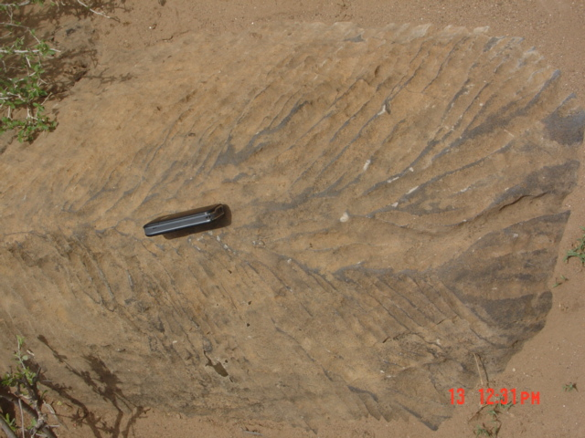
b) Erosional structures:-
Flute marks
Groove marks
Tool marks/channel solutions
solution flutes (rillenkarren)
Solution channel

Slide 23
C) Biogenic structures
Bioturbation structures
Biostratification structures
Characteristics of discontinuities (fracture & joint)
Orientation (strike/dip angle),
Spacing/frequency,
Aperture/opening,
Persistence,
Infilling materials,
Wall strength,
The presence of water,

Slide 24
The thickness of Infilling materials
The composition of Infilling materials ,
The nature of Infilling materials,
The surface of roughness,
In general, for the identification of sedimentary rock types in the field, the two principal features to note are:
Composition: grain, matrix and cement.
Texture _ Grain-size
_ Grain sorting
_ Grain morphology (shape & roundness)
_ Grain surface
_ Grain fabric

Slide 25
3.2. FIELD MAPPING OF IGNEOUS ROCKS
The main reasons to study igneous rocks are to:
Understand volcanoes and the hazards they pose to life on earth.
Understand processes beneath the earth’s surface that drive plate tectonics and that contributed to the evolution of earth and other planetary bodies.
Understand the distribution of ore minerals.
For chronology (age).
Igneous rocks can be classified based on:
Mode of occurrence,texture and Composition.
Magma is a complex mixture of liquid, solid & gas.

Slide 26
Mode of occurrence refers to the place where the igneous rocks are formed (crystallize).
Plutonic (Intrusive) rocks
Volcanic (Extrusive) rocks
Hypabyssal rocks
Texture refers:
to the size of the minerals with in the rock,
to the nature of the minerals (whether they are crystalline or not), and
to the way in which the mineral grains are arranged.

Slide 27
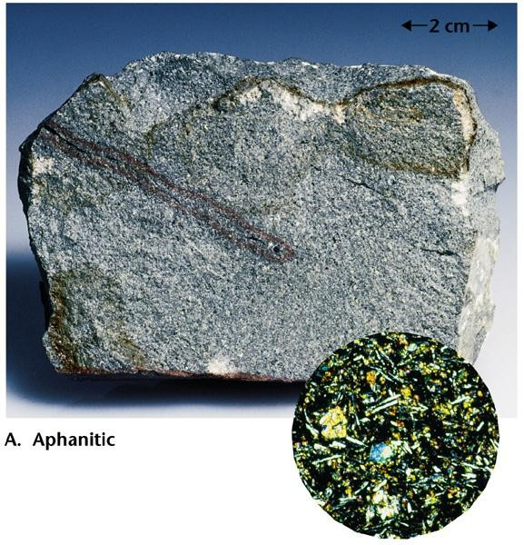
The texture of the igneous rocks depends on:
The mode of occurrence ;
The rate of cooling of the magma;
The depth, size, and shape of the cooling magma chamber.
The textures of igneous rocks are described as:
Aphanitic: is fine grained granular rocks that are formed by rapid cooling of lava at the surface of the earth. The crystals are so small that cannot be seen with the naked eye.

Slide 28
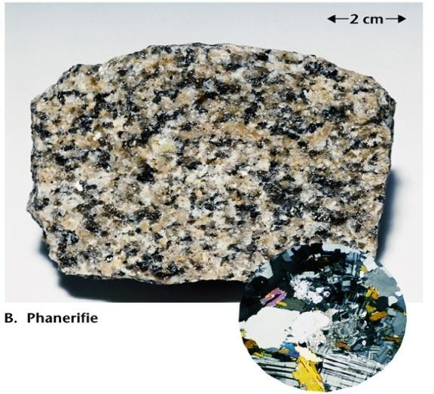
Phaneritic: is Coarse-grained granular rocks that are formed by slow cooling of magma beneath the surface of the earth. The crystals are so big that the individual crystals can be observed with the naked eye.

Slide 29
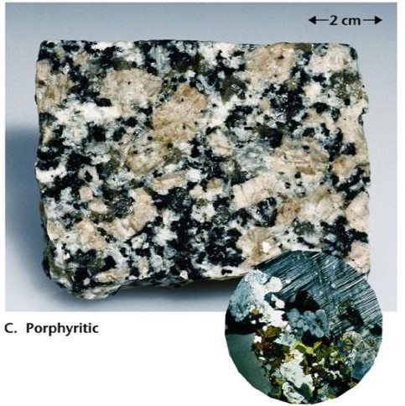
Porphyritic texture:- rocks that are composed of large (coarse) crystals set in fine ground mass. The coarse crystals are known as the Phenocrysts and the fine-grained as Ground Mass or Matrix. Such a texture results due to multi stage cooling of magma at different physical locations. The phenocrysts are formed when the magma solidifies beneath the surface of the earth while the ground mass is formed by the rapid cooling of the magma which rises to the surface.

Slide 30
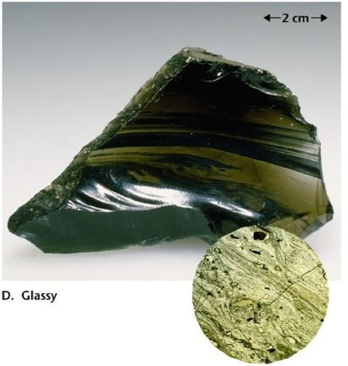
Vesicular: rocks that have vesicles (small non-penetrating cavities) on their surfaces. Vesicles are formed when the gases (volatiles) entrapped in the magma (lava) escaped rapidly in the form of bubbles when the lava rises to the surface and exposed to the atmosphere.
Amygdaloidal: vesicular rocks whose vesicles are filled by mineral precipitates (Amygdales) such as silica, calcite, etc.
Glassy texture
Very rapid cooling of lava

Slide 31
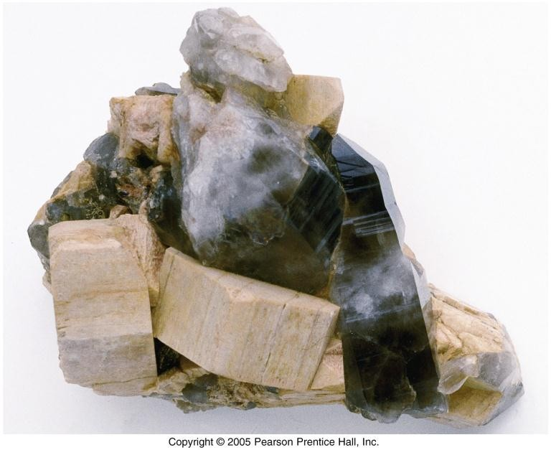
Pegmatitic texture
Exceptionally coarse grained.
Form in late stages of crystallization of granitic magmas.

Slide 32
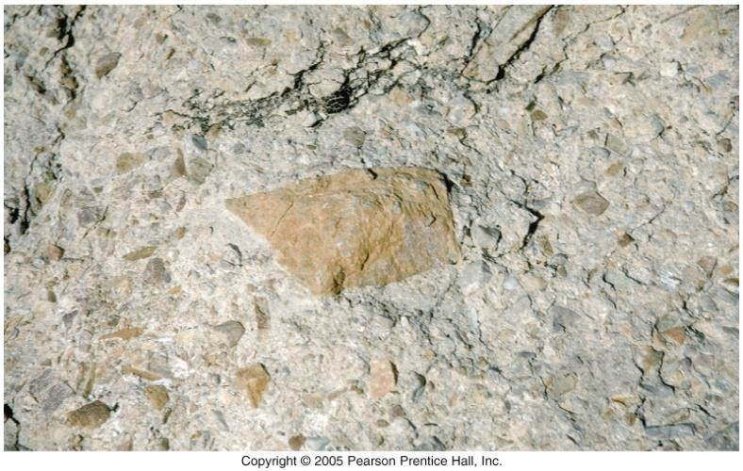
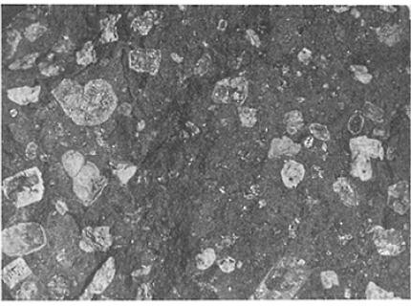
Pyroclastic texture
Fragmental appearance produced by violent volcanic eruptions.

Slide 33
Mineralogical composition refers the proportion of the dominant minerals with in the rock.
Felsic
Intermediate
Mafic
Ultramafic
Intrusive bodies are classified according to their size, shape, relationship with the surrounding rocks and their overall orientation.
According to the orientation of the intrusive body with respect to the surrounding rocks, we can classify the magma body as Concordant (when emplaced parallel to the plane of layering of the surrounding rocks) and Discordant (when it cuts across the layering along cracks).

Slide 34
Based on their dimension, we can classify as Tabular (an intrusive body whose thickness is relatively smaller than its other dimensions) and Massive (any intrusive form with proportional dimensions) bodies.
Sill: a concordant and tabular pluton which may be horizontal, inclined or vertical depending on the attitude of the rock structure with which it is concordant.
Dike: a discordant and tabular pluton, which is usually inclined or vertical, formed when magma forced its way through the fractures of adjacent rocks.
Lopolith: a concordant and tabular pluton shaped like a spoon, with both the roof and the floor sagging down ward.

Slide 35
4) Laccolith: a concordant and massive pluton whose floor is horizontal while its roof is arched upward forming a mushroom like structure, pushing the enclosing rocks up.
Batholith: a very large, discordant and massive pluton with no defined shape but its size increase as it extends downward and has no any determined root (floor).
Columnar joints, which are generally attributed to thermal contraction during cooling.
Columnar joints develop perpendicular to the cooling surfaces of tabular igneous bodies.
Veins in igneous rocks may be much younger than their host, as they can be in any rock type, so it is important which should be try to determine the significance of any veins that you find.

Slide 36
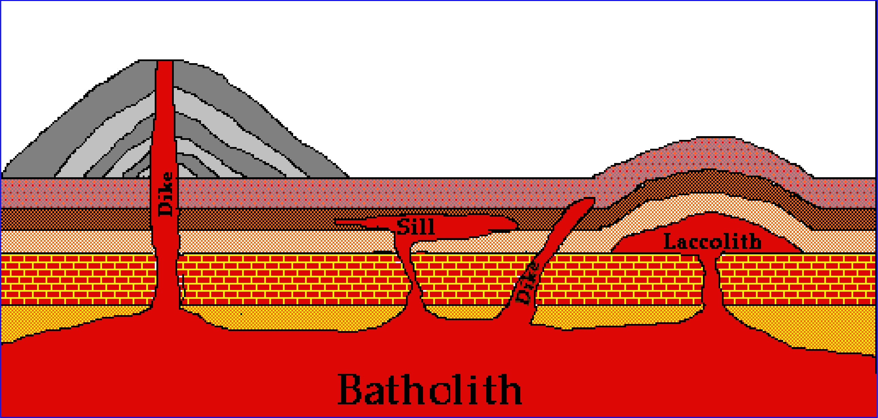

Slide 37
3.3. FIELD MAPPING OF METAMORPHIC ROCKS
Metamorphism :-is the transformations(modification) mineralogical composition , texture, & structure of rocks.
Agents of metamorphism
Heat
The role of temperature:-
Increases the mobility of ions and atoms
Increase the chemical reactivity.
Break chemical bonds
Alter the existing crystal structure.
Atoms and ions recrystallize to form new mineral assemblage.

Slide 38
The sources of heat:-
geothermal gradient
igneous intrusions
radioactive decay
frictional heat
2) Pressure
The role of Pressure:-
Volume change(expansion or contraction)
Change the shape and orientation of the crystals
The sources of Pressure
Buried deep in the crust

Slide 39
3) Metamorphic fluids
The role of metamorphic fluids
Enhances migration of ions
Aids in recrystallization of existing minerals
The Sources metamorphic of fluids:-
Pore spaces of sedimentary rocks
Fractures in igneous rocks
Hydrated minerals such as clays and micas
Texture refers to the size, shape, and arrangement of grains within a rock

Slide 40
Foliation – any planar arrangement of mineral grains or structural features within a rock
Foliated metamorphic rocks
Slate:- is a very fine-grained metamorphic rock that exhibits slaty cleavage. It is the result of low-grade regional metamorphism of shale or volcanic ash. The different colors of most slates are caused by minute amounts of graphite (black), iron oxide (red and purple), or chlorite (green).
Phyllite: are of a slightly higher grade than the slates but are of similar character and origin. Phyllites tend to have a more or less glassy or lustrous sheen from crystals of mica and chlorite that have grown a little larger than those of slates.

Slide 41
3) Schist:- is produced by medium-grade regional metamorphism. All schists contain more than 50% platy and elongated minerals, all of which are large enough to be clearly visible.
4) Gneissis:- a high-grade metamorphic rock that is streaked or has segregated bands of light and dark minerals.
Non foliated Metamorphic rocks
Hornfels: a high-grade contact metamorphic rock fine grain size.
Granofels: a high-grade contact metamorphic rock with coarse grain.
Serpentinite: an ultramafic rock metamorphosed at low grade, so that it contains mostly serpentine.
Eclogite: a green and red metamorphic rock that contains clinopyroxene and garnet .

Slide 42
5) Quartzite: medium to high-grade metamorphic rocks.
6) Marble: is the metamorphic product of heat and pressure acting on limestone and dolomites.
7) Argillite: is a low-grade non-foliated metamorphic rock made from a mudstone or other clay rich sedimentary rocks.
8) Greenstone: is a metamorphosed form of mafic volcanic rocks.
9) Amphybolite: is mostly non-foliated rock made up of amphibole and plagioclase feldspars.
10) Granulite: a high grade rock of pelitic, mafic, or quartzo-feldspathic parentage that is predominantly composed of OH-free minerals.

Slide 43
Generally in mapping of metamorphic rocks conside the ff points:
Is the rock layered,
Massive or patchy in appearance?
Are there cross - cutting relationships or contacts between different rock - types?
Is there an intrusion nearby?
You should note such gross features, as they are likely to provide critical clues to the original, pre - metamorphic lithology of the rock (its protolith), and suggest likely associations of rocks that may be present.

Slide 44
3.4. Recognition of geological contacts and structures
Contacts: - are boundaries that separate one rock body from another.
Depositional contact (sharp or gradational ).
Tectonic contact (fault &shear zone contact).
Intrusive contacts.
Unconformity contact.
Types of unconformities:
Parallel unconformity, disconformity
Para conformity
Angular unconformity
Nonconformity

Slide 45
1) Angular unconformity: is the older strata dip at an angle different from that of the younger beds.
2) Disconformity: are breaks in the rock record where the strata on both sides of the unconformity are essentially parallel.
3) Nonconformity: where the break separates older metamorphic or igneous rocks from younger sedimentary rocks.
4) Para conformity: The breaks in the rock record is difficult to identify or if not visible.
Structural measurements and notations
Planar features: true dip, apparent dip, strike & dip direction.
Leaner features: trend, pitch & plunge.
Notations: azimuth notations & quadrant/bearing notations

Slide 46
3.5 USE OF TOPOGRAPHIC MAPS AND IMAGES IN MAPPING
Map is the simplified, diminished scale, plane sheet representation of the real world location or objects.
Topographic maps is the three dimensional representation of the real world location or objects.
Use of topographic maps:-
Show altitudes of ground surfaces
Show specific formations/land form, such as mountains
To decide the best location engineering structures.
Show the contours and elevations of physical features are easy to understand.
To decide the best location groundwater.

Slide 47
Aerial photography
It is done by aircraft, helicopters, &rockets.
Aerial Photographs are taken by a camera in an airplane.
There's a theoretical upper limit to how high the photos can be taken.
It is necessarily implies atmospheric flight;
The trajectory of the craft taking the photos is ultimately suborbital.
The altitude varies depending on the purpose of the photo, but is typically about 5,000 - 30,000 feet.

Slide 48
Advantage of aerial photography:
May show more detail than map
Landform may be interpreted before mapping
Clear depiction of land features
Disadvantage of aerial photography:
Limited global converge
Costly & rare available for free
May be difficult to obtain for some area
No contour line &distortion may be occur

Slide 49
Satellite Image
Data is taken from a satellite in orbit around the earth.
The craft taking the photos is in Low Earth Orbit (LEO) or higher.
LEO is commonly accepted as beginning at about 100 miles.
They are taken above the atmosphere.
Satellite Image Data is taken by a Satellite orbit at an altitude of several hundred to several thousand miles.
Advantage satellite image:
Tend to show large area
More readily available
More information in different spectral band

Slide 50
Disadvantage satellite image:
Lower resolution than photograph
Relief often less clear
No contour line &distortion may be occur
What can we determine from aerial photos ?
Volcanic flows extent .
Layering of rocks .
Strike and dip of rocks .
Magmatic intrusion extent .
Alluvial deposits extent & avalanches .

Slide 51
Slope stability study.
Location of landslides mapped .
Location of the geological structures (faults, joints & fractures).
River meanders (old abandoned channels)
High water table conditions.
Location of the sinkholes.

