Slide 1
ECONOMETICS II: Chapter Two
2. Introduction to Time series Econometrics
The nature of Time Series Data
Stationary and non-stationary stochastic Processes
Trend Stationary and Difference Stationary Stochastic Processes
Integrated Stochastic Process
Tests of Stationarity: The Unit Root Test
Co-integration
Spurious regression

Slide 2
2.1. Nature of time series data
Many of the principles and properties that we studied in cross-section econometrics carry over when our data are collected over time.
However, time-series data present important challenges that are not present with cross sections and that warrant detailed attention.
Time series data has a temporal ordering, unlike cross-section data.
Past can affect the future, but not vice versa.
So, we will need to alter some of our assumptions to take into account that we no longer have an usual random sample of individuals.
Instead, we have one realization of a stochastic process. (i.e. random)

Slide 3
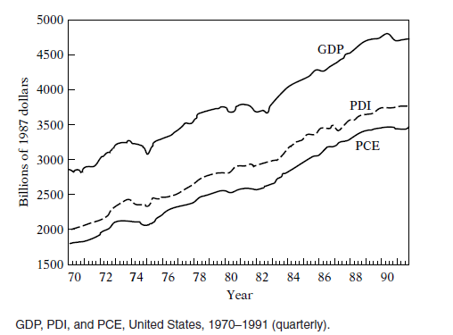
Random variables that are measured over time are often called “time series.”
A random or stochastic process is a collection of random variables ordered in time. If we let Y denote a random variable, and if it is continuous, we
denote it as Y(t), but if it is discrete, we denoted it as Yt.

Slide 4
2.2. Stationary and non-stationary stochastic Processes
Stationary time series (stochastic process)
X_{t} is stationary if the series exhibits mean reversion
i.e. fluctuates around a constant long run mean.
X_{t} has finite variance which is not dependent upon time.
Covariance between two values of X_{t} depends only on the difference apart in time.
E(X_{t}) = μ (mean is constant in t)
Var(X_{t}) = σ² (variance is constant in t)
Cov(X_{t} ,X_{t+k}) = χ(k) (covariance is constant in t)
A stochastic process is said to be stationary if its mean and variance are constant over time and the value of the covariance between the two time periods depends only on the distance or gap or lag between the two time periods and not the actual time at which the covariance is computed.

Slide 5
Stationary time series
Stationarity is a rather intuitive concept, it means that the statistical properties of the process do not change over time.
There are two important forms of Stationarity:
Strong (strictly) Stationarity;
weak Stationarity.
A time series is strictly stationary if all the moments of its probability distribution and not just the first two (i.e., mean and variance) are invariant over time.
Weak Stationarity only concerns the shift-invariance (in time) of 1st and second moments of a process.
0.6
0.4
0.2
0
-0.2
-0.4
-0.6
Year

Slide 6
ii. Non-stationary time series
If a time series is not stationary in the sense just defined, it is called a non-stationary time series (keep in mind we are talking only about weak Stationarity). In other words, a non-stationary time series will have a time varying mean or a time-varying variance or both.
In contrast a non-stationary time series has the following characteristics
Does not have a long run mean which the series returns
Variance is dependent upon time and goes to infinity as the sample period approaches infinity
Corre-logram does not die out - long memory

Slide 7
Non-stationary time series
GDP (Y_{t})
The level of GDP (Y) is not constant and the mean increases over time. Hence the level of GDP is an example of a non-stationary time series. Although our interest is in stationary time series, one often encounters non-stationary time series, the classic example being the random walk model (RWM).

Slide 8
Non-stationary time series: Random Walk X_{t} = X_{t-1} + u_{t}

Slide 9
Non-stationary time series: RANDOM WALK
X_{t} = X_{t-1} + u_{t}
Mean: E(X_{t}) = E(X_{t-1}) (mean is constant in t)
X₁ = X₀ + u₁ (take initial value X₀)
X₂ = X₁ + u₂ = (X₀ + u₁ ) + u₂
…
X_{t} = X₀ + u₁ + u₂ +…+ u_{t}
E(X_{t}) = E(X₀ + u₁ + u₂ +…+ u_{t}) (take expectations)
= E(X₀) = constant
Variance: Var(X_{t}) = Var(X₀) + Var(u₁) +…+ Var(u_{t})
= 0 + σ² +…+ σ²
= t σ² (variance is not constant through time)
Two types of random walks:
random walk without drift (i.e., no constant or intercept term) and
random walk with drift (i.e., a constant term is present).

Slide 10
1. Random Walk without Drift. Suppose u_{t} is a white noise error term with mean 0 and variance $σ^{2}$. Then the series X_{t} is said to be a random walk if X_{t}=X_{t-1}+u_{t} In the random walk model, the value of X at time t is equal to its value at time (t−1) plus a random shock u_{t.} X_{t}=X_{t-1}+u_{t} X₂=X₁+u₂=(X₀+u₁)+u_{2 …} X_{t}=X₀+u₁+u₂+…+u_{t} In general, if the process started at some time 0 with a value of X₀, we have X_{t} =X₀+$\sum{\text{u}\text{t}}$

Slide 11
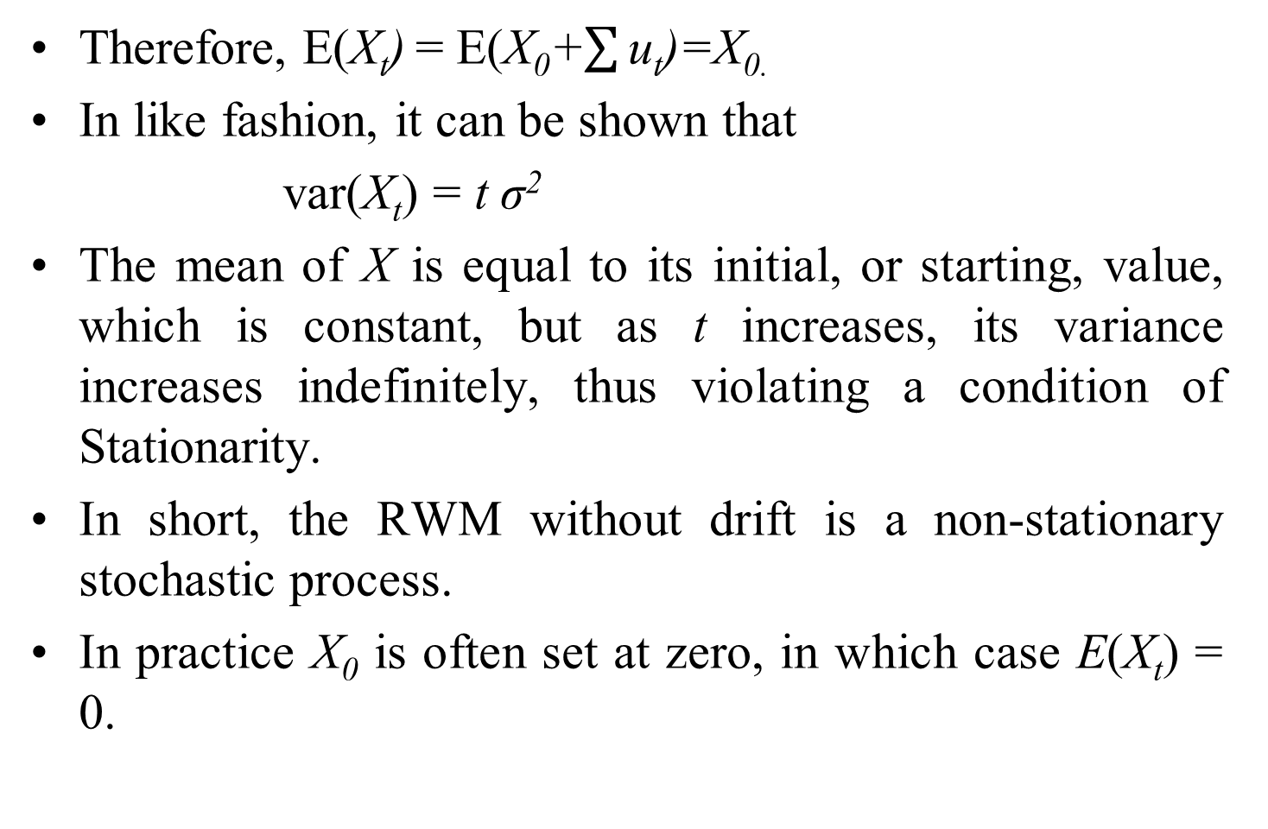
Therefore, E(X_{t}) = E(X₀+$\sum{\text{u}\text{t}}$)=X_{0.}
In like fashion, it can be shown that
var(X_{t}) = t σ²
The mean of X is equal to its initial, or starting, value, which is constant, but as t increases, its variance increases indefinitely, thus violating a condition of Stationarity.
In short, the RWM without drift is a non-stationary stochastic process.
In practice X₀ is often set at zero, in which case E(X_{t}) = 0.

Slide 12
Random walk have an infinite memory. As Kerry Patterson notes, random walk remembers the shock forever!!!
2. Random Walk with Drift
$Xt=δ+Xt−1+ut$
where δ is known as the drift parameter.
$$X_{t}−Xt−1=∆X_{t}=δ+ut$$
It shows that $X_{t}$drifts upward or downward, depending on δ being positive or negative.
E(X_{t}) = E($δ$+X₀+$\sum{\text{u}\text{t}}$)=X₀ +t $δ$
var(X_{t}) = t σ²
For RWM with drift the mean as well as the variance increases over time, again violating the conditions of (weak) Stationarity. In short, RWM, with or without drift, is a non-stationary stochastic process.

Slide 13
Trend and Difference Stationary Stochastic Processes
A trending mean is a common violation of stationarity. There are two popular models for non-stationary series with a trending mean.
Trend stationary: The mean trend is deterministic. Once the trend is estimated and removed from the data, the residual series is a stationary stochastic process.
Difference stationary: The mean trend is stochastic. Differencing the series D times yields a stationary stochastic process.
If the trend in a time series is completely predictable and not variable, we call it a deterministic trend, whereas if it is not predictable, we call it a stochastic trend.

Slide 14
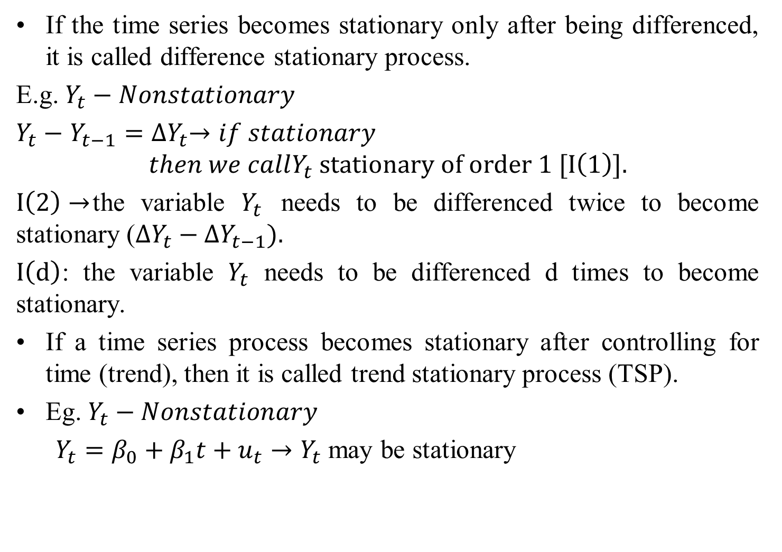
If the time series becomes stationary only after being differenced, it is called difference stationary process.
E.g. $Y_{t}−Nonstationary$
$Y_{t}−$ $Y_{t−1}={∆Y}_{t}→if stationary$
$$then we callY_{t} stationary of order 1 [I\left(1\right)].$$
$I\left(2\right)→$the variable $Y_{t}$ needs to be differenced twice to become stationary (${∆Y}_{t}−{∆Y}_{t−1}).$
$I\left(d\right)$: the variable $Y_{t}$ needs to be differenced d times to become stationary.
If a time series process becomes stationary after controlling for time (trend), then it is called trend stationary process (TSP).
Eg. $Y_{t}−Nonstationary$
$Y_{t}=β_{0}+β_{1}t+u_{t}→Y_{t}$ may be stationary

Slide 15
Spurious regression
Assume that $\left\{\begin{aligned}Y_{t}= Y_{t−1}+u_{yt} \\ X_{t}= X_{t−1}+u_{xt}\end{aligned}\right\}Y_{t} and X_{t} are non−stationary.$
And run this model: $\left\{\begin{aligned}Y_{t}=β_{0}+β_{1}X_{t}+u_{t} \\ R^{2}→very high \\ F→very high \\ t→very high \\ DW→low\end{aligned}\right\}such a \text{"}\text{seemingly}\text{−}\text{good}"$
$$model is called spurious regression (Non−sense)!$$
Rule of thumb for spurious regression suspecting is $R^{2}>DW$(Durbin Watson statistics)

Slide 16
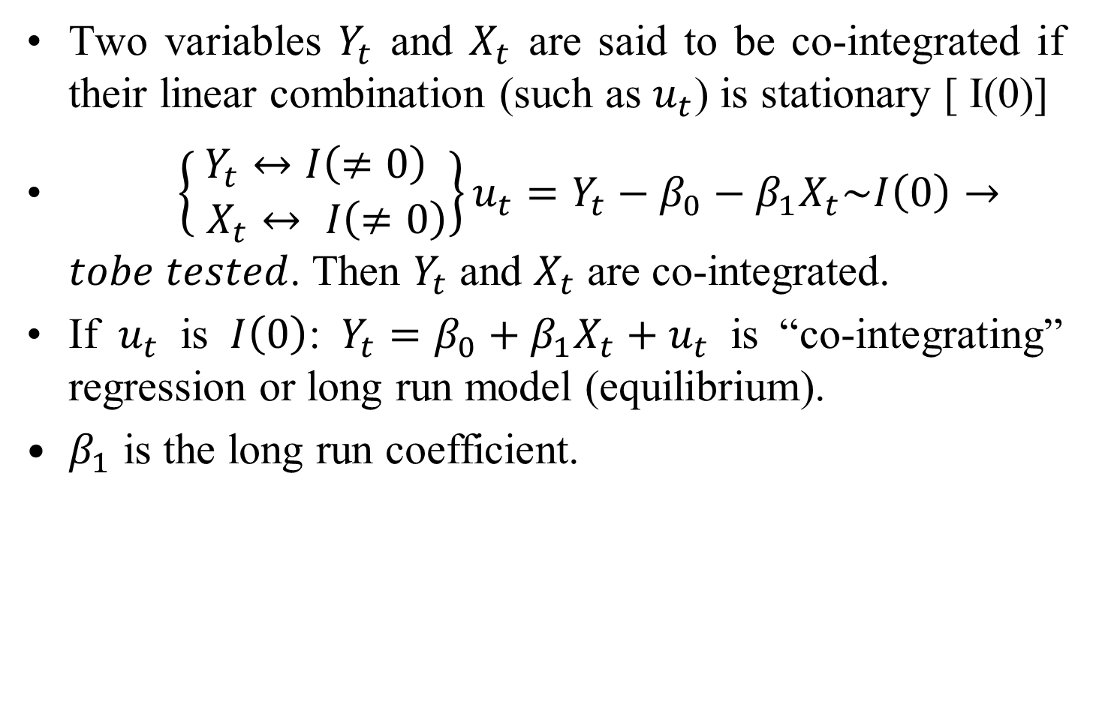
Co-integration
Two variables $Y_{t}$ and $X_{t}$ are said to be co-integrated if their linear combination (such as $u_{t}$) is stationary [ I(0)]
$\left\{\begin{aligned}Y_{t}↔I\left(≠0\right) \\ X_{t}↔ I\left(≠0\right)\end{aligned}\right\}{u_{t}=Y_{t}−β_{0}−β_{1}X}_{t}\sim I\left(0\right)→tobe tested$. Then $Y_{t}$ and $X_{t}$ are co-integrated.
If $u_{t}$ is $I\left(0\right)$: ${Y_{t}=β_{0}+β_{1}X}_{t}+u_{t}$ is “co-integrating” regression or long run model (equilibrium).
$β_{1}$ is the long run coefficient.

Slide 17
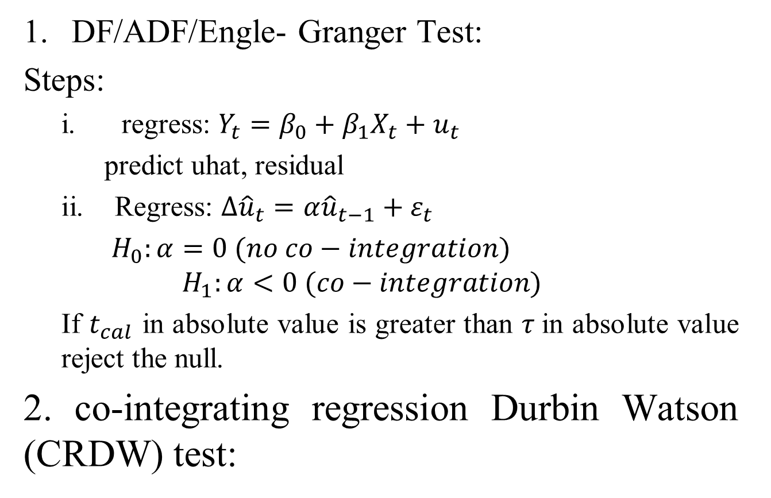
Testing for co-integration
DF/ADF/Engle- Granger Test:
Steps:
regress: ${Y_{t}=β_{0}+β_{1}X}_{t}+u_{t}$
predict uhat, residual
Regress: $∆{\hat{u}}_{t}=α{\hat{u}}_{t−1}+ε_{t}$
$H_{0}:α=0 (no co−integration)$
$$H_{1}:α<0 (co−integration)$$
If $t_{cal}$ in absolute value is greater than $τ$in absolute value reject the null.
2. co-integrating regression Durbin Watson (CRDW) test:

Slide 18
Error Correction Mechanism (ECM) [short run model]
For having a long run relationship it is a must that short run disequilibria are corrected.
The error term itself is responsible to correct using its one period lag. The associated model is called ECM.
For the long run model: ${Y_{t}=β_{0}+β_{1}X}_{t}+u_{t}$ the ECM is given as: ${{∆Y}_{t}=α_{0}+α_{1}∆X}_{t}+α_{2}{\hat{u}}_{t−1}+ε_{t}$.
${\hat{α}}_{2}$: is the error correction (adjustment) coefficient.
E.g. $Y_{t}=lnY$
$X_{t}=lnX$
${\hat{α}}_{2}$: every year to have a long run equilibrium, it needs to make 100${\hat{α}}_{2}$% “adjustment” in the short run.
$α_{1}$: short run coefficient [OLS marginal effect: in the short run a 1% increase in X….]

Slide 19
Constant covariance - use of correlogram
Covariance between two values of X_{t} depends only on the difference apart in time for stationary series.
Cov(X_{t} ,X_{t+k}) = χ(k) (covariance is constant in t)
(A) Correlation for 1980 and 1985 is the same as for 1990 and 1995. (i.e. t = 1980 and 1990, k = 5)
(B) Correlation for 1980 and 1987 is the same as for 1990 and 1997. (i.e. t = 1980 and 1990, k = 7)

Slide 20
Non-stationary time series
UK GDP (Y_{t})
However, the level of a economic time series is typically non-stationary.
The level of GDP (Y) is not constant and the mean increases over time.

Slide 21
Stationary time series
First difference of GDP is stationary
ΔY_{t} = Y_{t} - Y_{t-1}
- Growth rate is reasonably constant through time.
Variance is also reasonably constant through time

Slide 22
Non-stationary Time Series: summary
Relationship between stationary and non-stationary process
AutoRegressive AR(1) process
X_{t} = α + ρX_{t-1} + u_{t} u_{t} ~ IID(0, σ² )
ρ < 1 stationary process
- “process forgets past”
ρ = 1 non-stationary process
- “process does not forget past”
α = 0 without drift
α ≠ 0 with drift

Slide 23
Stationary time series with drift X_{t} = α + 0.5*X_{t-1} + u_{t} u_{t} ~ IID(0, σ² )

Slide 24
Non-stationary time series: Random Walk with Drift X_{t} = α + X_{t-1} + u_{t} u_{t} ~ IID(0, σ² )
Time series models: General Models
Auto-Regressive AR(1) process without drift
X_{t} = ρX_{t-1} + u_{t}
ρ < 1 stationary process
- “process forgets past”
ρ = 1 non-stationary process
- “process does not forget past”
Autoregressive AR(k) process without drift
X_{t} = ρ₁X_{t-1} + ρ₂X_{t-2} + ρ₃X_{t-3} + ρ₄X_{t-4} +…+ ρ_{k}X_{t-k} + u_{t}

