Slide 1
Chapter 4፡ The Business Plan An old Say
“Tell me and I will forget,
show me and I will remember,
involve me and I will understand”

Slide 2
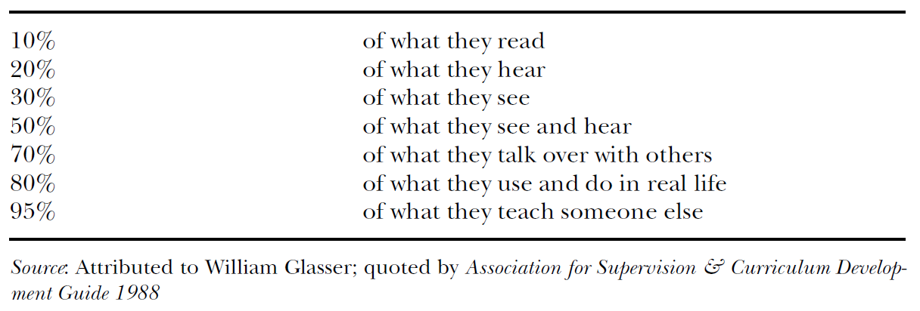
Most people learn…

Slide 3
Learning takes place through the active behavior of the student: it is what he does that he learns, not what the teacher does. Ralph W. Tyler (1949)
If students are to learn desired outcomes in a reasonably effective manner, then the teacher’s fundamental task is to get students to engage in learning activities that are likely to result in their achieving those outcomes. . . . It is helpful to remember that what the student does is actually more important in determining what is learned than what the teacher does. Thomas J. Shuell (1986)

Slide 4
How much do you agree with this say
“it is science and engineering students in particular whose entrepreneurial activities create new, high-quality firms (Åstebro et al., 2012) that ultimately contribute to job growth (Kirchhoff, 1994). Strengthening this human capital basis for technology-based entrepreneurship may be vital, especially for regions affected by an economic crisis”

Slide 5
What characteristics do you innovate
location,
flavor,
price,
size,
experience
?????????

Slide 6
4.1. The Concept of Business Plan
Why is planning?
Planning is the process of setting objectives and devising actions to achieve those objectives, answers the questions
What business am I in?
Where can I find needed personnel?
What finances do I need?
How much profit can I expect?
What is my sales strategy?
Planning is a process that never ends for a business though it is extremely important in the early stages of any new venture when the entrepreneur will need to prepare a preliminary business plan.

Slide 7
As the venture evolves from an early start-up to a mature business, planning will continue as management seeks to meet its short­ term or long-term business goals.
For any given organization, it is possible to find
Financial plans,
Marketing plans,
Human resource plans,
Production plans, and
Sales plans.
Plans may be short-term or long-term, or they may be strategic or operational.
Plans will also differ in scope depending on the type of business or the anticipated size of the start up operation.

Slide 8
What is Business Plan?
Business plan is the formal written expression of the entrepreneurial vision, describing the strategy and operation of the proposed venture.
It is also a loan proposal, venture plan, or investment prospectus.
However, not all business plans are the same because businesses are different, products are different, they are prepared for different reasons and they vary in importance.

Slide 9
For the entrepreneur starting a new venture, a business plan has four basic objectives:
It identifies the nature and the context of the business opportunity­ why does such an opportunity exist.
It presents the approach the entrepreneur plans to exploit the opportunity.
It identifies the factors that will most likely determine the success of the venture.
It serves as a tool to raise financial capital.

Slide 10
A business plan can be viewed as an entrepreneur's game plan
it crystallizes the dreams and hopes that motivates the entrepreneur to start the business.
bridges between an idea and reality.
A business plan can be a response to some changes in the external environment that presents new opportunities.
Therefore, writing a business plan should be thought of as ongoing process and as the means to an end product.

Slide 11
4.2. Importance of the Business Plan
The major benefits of a sound business plan are.
Arranging strategic alliance: strategic alliances are arrangements between large and small companies to carryout joint research, marketing, and other activities.
Seeking investment funds: venture capitalists and investors require a business plan from any company that wants to be taken seriously for funding the venture.
It reduces the anxieties and tension of the entrepreneur. By projecting the risk of the new venture into the future, the entrepreneur comes to grasps with potential negative outcomes and the possibility of failures.
Obtaining bank financing: only those having the best business plan will receive funds from bank.

Slide 12
It helps to obtaining large contract.
Completing mergers and acquisitions: Your business plan can inspire the confidence essential to complete the deal, i.e. to sell your company or to acquire the other companies.
Attracting key employees: Usually, people doubt about the sustainability of companies during their inspection.
Motivating the management team: A written business plan that is based on input from all members of the company’s management team and/or distributed to all managers ensures that everyone understands where the company is headed.
It provides self-assessment of the entrepreneur. A well-prepared business plan enables an entrepreneur to see whether the business is assured of success.

Slide 14
4.4. Essentials of a sound business plan
To make persuasive your business plan consider the following points:
Comprehensive: the business plan has to fully and completely treat all the major issues facing the new venture.
Communicative: the business plan is a document for communicating to various audiences the business’s concepts and potential.
Guidance: the business plan can be referred repeatedly to guide decisions of the firm’s managers and employees.
The planning process/flexible: the process of putting together a business plan, consulting it frequently, and reviewing and revising it periodically can improve the venture’s performance even through some aspects of the plan may become obsolete before the ink dry.

Slide 15
4.5. Developing/Preparing the Business Plan
In preparing the business plan the entrepreneur, himself must sit still long enough to do it. Hiring someone to write the business plan is not acceptable substitute; entrepreneurs should undertake the task personally. Although outsider consultants, accountants and lawyers should be tapped for their advice and expertise, the founder or the initial management team should be responsible for the preparation of the business plan.
The business should be comprehensive
Although all business plans contains certain key elements, the content and the organization (format) varies greatly on the nature of the business
The outline, which is presented below shows some of the major points to be covered while preparing the business plan.

Slide 16
I. Introductory Page
This is the title or cover page that provides a brief summary of the business plan's contents. The introductory page should contain the following:
The name and address of the company.
The name of the entrepreneur(s) and a telephone number.
A paragraph describing the company and the nature of the business.
The amount' of financing needed: The entrepreneur may offer a package that is stock, debt, and so on. However, many venture capitalists prefer to structure this package in their own way.
A statement of the confidentiality of the report: This is for security purposes and is important for the entrepreneur.
This title page sets out the basic concept that the entrepreneur is attempting to develop. Investors consider it important because they can determine the amount of investment needed without having to read the entire plan.

Slide 18
Sample introductory page
XYZ Procurement Service
Axum Town Kebele 05, Hamed Gebez
Co-owners: X, Y&Z Tel.______, ______,______
Description of Business
This business will provide purchasing and procurement service of fast moving items on a contract basis to small and medium-sized businesses.
Services include collecting pro forma invoice, screening out potential vendors and awarding the winning bidder and purchasing the products in accordance with the description in the purchase order. Contracts will be for one year and will specify the specific services and scheduling for completion of services.

Slide 19
Financing
Initial financing requested is a 150,000 Birr loan to be paid off over 5 years. This debt will cover office space, office equipment and supplies, one leased van, advertising and selling costs.
Statement of Confidentiality
This report is confidential and is the property of the co-owners listed above. The persons to whom it is transmitted and any reproduction or disclosure of any of its contents without the prior written consent of the company is prohibited intend it only for use.

Slide 20
II. Executive Summary
This section of the business plan is prepared after the total plan is written. About three to four pages in length, the executive summary should stimulate the interest of the potential investor.
The investor uses the summary to determine if the business plan is worth reading in total. Thus, it would highlight concisely and convincingly the key points in the business plan, that is, the nature of the venture, financing needed, market potential, and support as to why it will succeed.

Slide 21
III) Industry Analysis
Discussion of the industry outlook, including future trends and historical achievements, should be included. The entrepreneur should also provide insight on new product developments in this industry.
Competitive analysis is also an important part of this section. Each major competitor should be identified, with appropriate strengths and weaknesses described particularly as to how they might affect the new venture's potential success in the market.
Who is the customer? The market should be segmented and the target market for the entrepreneur identified. Any forecasts made by the industry or by the government should be noted. The potential investor may view a high growth market more favorably.

Slide 22
iv) Description of the Venture
The venture should be detailed in this section of the business plan.
Key elements, the product(s), the location and size of the business, the personnel and office equipment that will be needed, the background of the entrepreneur(s), and the history of the venture.
What are the product(s)?
Describe the product(s), including patent, Copyright or trademark status
Where will the business be located?
Is the building new or old? In need of renovations (If renovation needed, state costs)
Is the building leased or owned? (State the term)

Slide 23
What additional skills or personnel will be needed to operate the business?
What office equipment is needed?
Will equipment be purchased or leased?
What management experience do you have?
Describe personal data such as education, age, special abilities and interests
What are your reasons for going into business?
Why will you be successful in this venture?
What development work has been completed to date?

Slide 24
V) Production/Operation Plan
If the new venture is a manufacturing operation, a production plan is necessary. This plan should describe the complete manufacturing process. If some or all of the manufacturing process is to be subcontracted, the plan should describe the subcontractor(s), including location, reasons for selection, costs, and any contracts that have been completed.
physical plant layout; the machinery and equipment needed to perform the manufacturing operations; raw materials and suppliers' names, addresses, and terms; costs of manufacturing; and any further capital equipment -needs.
In a manufacturing operation, the discussion of these items will be important to any potential investor in assessing financial needs.

Slide 25
If the venture is not a manufacturing - operation but a retail store or service, this section would be titled "merchandising plan" and purchase of merchandise, inventory control system, and storage needs should be described. Some of the key questions for this section of the business plan are the following:
From whom will merchandise be purchased?
How will the inventory control system operate?
What are storage needs of the venture - and how will they be promoted?

Slide 26
VI) Marketing Plan
The marketing plan describes how the product(s) will be priced, promoted and distributed. Specific forecasts for product(s) are indicated in order to project profitability of the venture.
Potential investors regard the marketing plan as critical to the success of the new venture.

Slide 27
VII) Organizational Plan
The organizational plan describes the venture's form of ownership - that is, proprietorship, partnership, or corporation. For instance, if the venture is a partnership, the terms of the partnership should be included. If the venture is a corporation, it is important to detail the shares of stock authorized, share options, names and addresses and resumes of the directors and officers of the corporation.
It is also helpful to provide an organization chart indicating the line of authority and the responsibilities of the members of the organization.
This information provides the potential investor with a clear understanding of who controls the organization and how other members will interact in performing their management functions.

Slide 28
VIII) Assessment of Risk
Every new venture will be faced with some potential hazards, given the particular industry and competitive environment. It is important that the entrepreneur makes an assessment of risk and prepares an effective strategy to deal with them.
Major risks for a new venture could result from a competitor's reaction; weaknesses in the marketing or production, and new advances in technology that might render the new product obsolete.
Even if these factors present no risks to the new venture, the business plan should discuss why that is the case.
It is also useful for the entrepreneur to provide alternative strategies should any of the above risk factors occur.
These contingency plans and strategies illustrate to the potential investor that the entrepreneur is sensitive to important risks and is prepared should any occur.

Slide 29
IX) Financial Plan:
Determines the potential investment commitment needed for the new venture and indicate whether the business plan is commercially feasible.
Three financial areas are covered in this section of the business plan.
First, the entrepreneur should summarize the forecasted sales and appropriate expenses for some years. It includes the forecasted sales, cost of goods sold, and the general and administrative expenses.
Second, cash flow figures must be presented for some years.
Third, the projected balance sheet should be presented.
It shows the financial condition of the business at a specific time. It also summarizes the assets of the business, its liabilities, the investment of the entrepreneur and any partners, and retained earnings or cumulative loses.

Slide 30
Appendix:
This part generally contains any back up material that is not necessary in the text of the document.
Letters from customers, distributors, or subcontractors are examples of the information that should be included in the appendix.

Slide 31
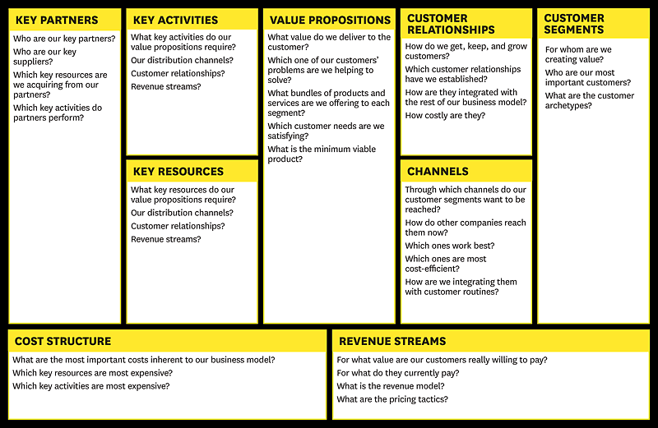
Business Model Canvas (key Element of Business plan)
Source: Osterwalder A. & Pigneur Y. (2010)

Slide 32
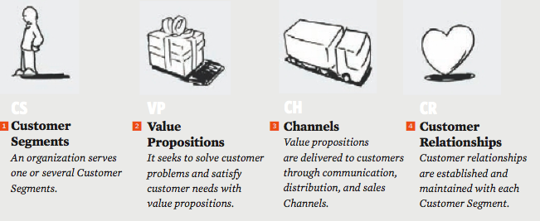
Building blocks 1 to 4

Slide 33
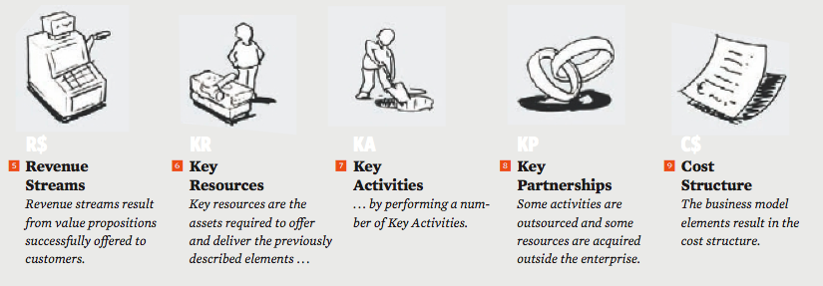
Building blocks 5 to 9

Slide 34
1. Customer Segments
ID & DEFINE THE DIFFERENT GROUPS OF PEOPLE OR ORGANIZATIONS AN ENTERPRISE YOUR BUSINESS AIMS TO REACH AND SERVE
MAKE A CONSCIOUS DECISION ABOUT WHICH SEGMENTS TO SERVE AND WHICH SEGMENTS TO IGNORE
SEPARATE CUSTOMER SEGMENTS IF:
their needs require and justify a distinct offer;
they are reached through different distribution channels;
they require different types of relationships;
they have substantially different profitability’s; and
they are willing to pay for different aspects of the offer

Slide 35
2. Value Proposition
FOR EACH CUSTOMER SEGMENT
DESCRIBE THE BUNDLE OF PRODUCTS AND SERVICES THAT CREATE VALUE FOR EACH SPECIFIC CUSTOMER SEGMENT
IDENTIFY THE REASON WHY CUSTOMERS WILL TURN TO YOUR COMPANY OVER ITS COMPETITORS. IT SOLVES A CUSTOMER PROBLEM OR SATISFIES A CUSTOMER NEED

Slide 36
3. Distribution Channels
DESCRIBES HOW YOUR COMPANY COMMUNICATES WITH AND REACHES ITS CUSTOMER SEGMENTS TO DELIVER THE VALUE PROPOSITION
DEFINE THE:
COMMUNICATION CHANNELS
DISTRIBUTION CHANNELS
SALES CHANNELS

Slide 37
4. Customer Relations
DESCRIBES THE TYPES OF RELATIONSHIPS YOUR COMPANY NEEDS TO ESTABLISH AND NURTURE WITH SPECIFIC CUSTOMER SEGMENTS
FOCUSED ON:
CUSTOMER ACQUISITION
CUSTOMER RETENTION

Slide 38
5. Revenue streams
ID FOR WHAT VALUE IS EACH CUSTOMER SEGMENT TRULY WILLING TO PAY?
ID AND QUANTIFY THE CASH YOUR COMPANY CAN GENERATE FROM EACH CUSTOMER SEGMENT THROUGH ONE OR MORE REVENUE STREAMS (SALES PIPELINES)
CONSIDER TWO DIFFERENT TYPES OF REVENUE STREAMS:
TRANSACTION REVENUES (RESULTING FROM ONE-TIME CUSTOMER PAYMENTS)
RECURRING REVENUES (RESULTING FROM ONGOING PAYMENTS)

Slide 39
6. Key Resources
ID, DESCRIBE AND QUANTIFY THE ASSETS, e.g.
LAND
BUILDINGS
EQUIPMENT
FACILITIES
PLATFORMS
SYSTEMS
TECHNOLOGY
REQUIRED TO DELIVER ON THE VALUE PROPOSITION TO EACH OF THE IDENTIFIED CUSTOMER SEGMENTS

Slide 40
7. Key Activities
ID, DEFINE AND DESCRIBE THE MOST IMPORTANT THINGS (ACTIONS) YOUR COMPANY MUST DO TO:
TO CREATE AND OFFER A VALUE PROPOSITION
REACH MARKETS
MAINTAIN CUSTOMER RELATIONSHIPS
EARN REVENUES
TO MAKE ITS BUSINESS MODEL WORK
TO OPERATE SUCCESSFULLY

Slide 41
8. Key Partnerships
ID AND DESCRIBES THE NETWORK OF SUPPLIERS AND PARTNERS THAT MAKE THE BUSINESS MODEL WORK, e.g.:
STRATEGIC ALLIANCES BETWEEN NON-COMPETITORS;
CO-OPERATION: STRATEGIC PARTNERSHIPS BETWEEN COMPETITORS;
JOINT VENTURES TO DEVELOP NEW BUSINESSES;
BUYER-SUPPLIER RELATIONSHIPS TO ASSURE RELIABLE SUPPLIES

Slide 42
9. Cost Structure
ID AND QUANTIFY ALL COSTS INCURRED TO SUCCESSFULLY OPERATE THE BUSINESS MODEL
Manufacturing costs (variable)
Operating costs (fixed)
DETERMINE VIABILITY:
Average Sales price per unit
less Average Manufacturing cost per unit
Equals the Average Contribution per unit
Number of units manufactured and sold x contribution per unit = Gross Margin
Gross Margin – Overheads = Net Margin

Slide 43
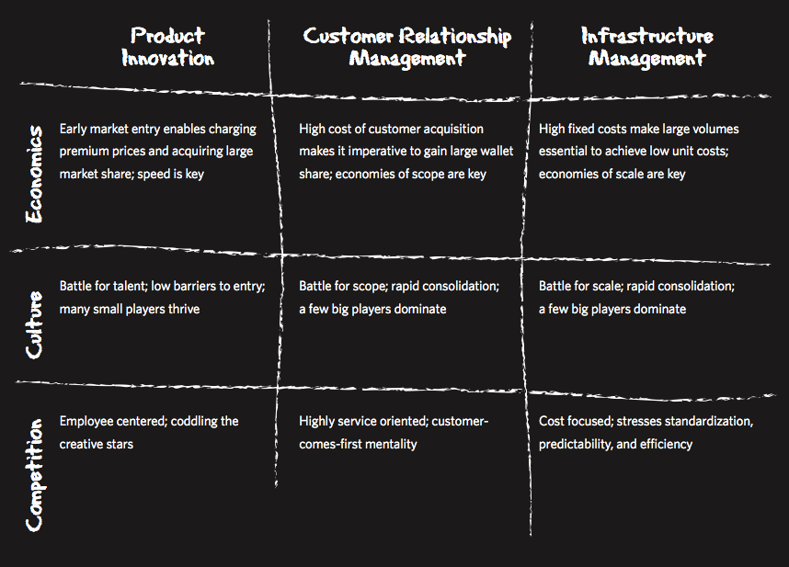
Business Model Patterns
1. THREE FUNDAMENTALLY DIFFERENT TYPES OF BUSINESS CONCEPTS COULD CO-EXIST IN ONE BUSINESS, BUT IS MORE EFFECTIVELY UNBUNDLED:
CUSTOMER RELATIONSHIP BUSINESSES;
PRODUCT INNOVATION BUSINESSES; AND
INFRASTRUCTURE BUSINESSES

Slide 44
Business Model Patterns
2. BUSINESS STRATEGY IS TO BE DECIDED UPON, e.g. targeting niche markets
* Price / costs
1.
Cost leadership
strategy
* Design
Niche strategy
* Quality
2.
Differentiation
* Service
strategy
* Availability
3.
*
* Safety
*

Slide 45
Business Model Patterns
3. NETWORK EFFECT through multi-sided platforms, which bring together two or more distinct but interdependent groups of customers, which platforms are of value to one group of customers only if the other groups of customers are also present, e.g. google
*
*

Slide 46
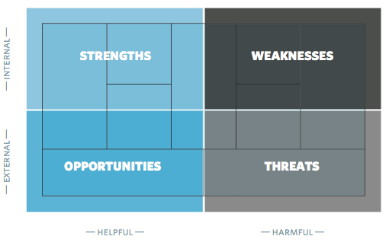
Evaluating Business Models

Slide 47
Assessing Value Propositions

Slide 48
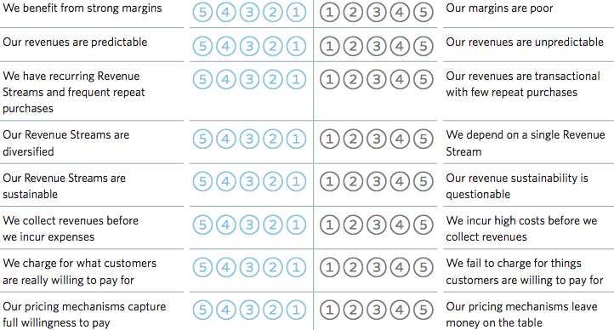
Assessing Revenue Streams

Slide 49
Assessing Cost Structures

Slide 50
Assessing Key Resources

Slide 51
Assessing Key Activities

Slide 52
Assessing Key Partnerships

Slide 53
Assessing Key Partnerships

Slide 54
Assessing Customer Segments

Slide 55
Assessing Relationships

Slide 56
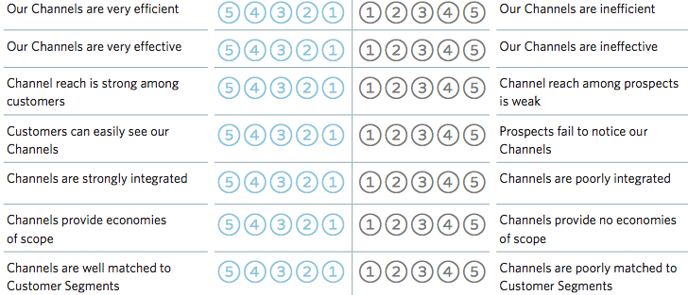
Assessing Channels

Slide 57
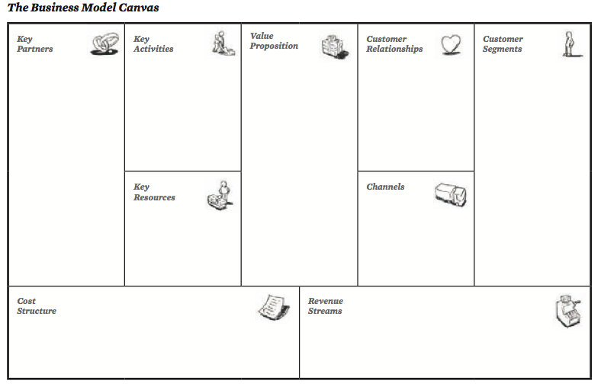
Business Model Canvas

Slide 58
Business idea: packing of egg and meat
Key partners | Key activities | Value proposition | Customer relationships | Customer segments
-MoA -Metema woreda industry office SME agents Super markets Coworkers Suppliers (incubation, chicken) | -inputs buying -incubating -menu preparation -drilling water -fencing -controlling day to day neatness of the site -feeding to the chickens -retailing Key resource | To satisfy customer livestock based food needs Improve Nutrition diets Decrease wastage to reduce customer price | Customer winning Customer retention CHANEELS -face to face lecture -videos -field visit | -international exposed customer -star hotels -tourists -local retailers -local consumers
Cost structure -start-up capital (equipments , chickens, incubators, packing machine, chemicals……..) -payroll cost -natural resource (land leasing, water drilling cost…) |  |  |  | Revenue streams -packed egg -packed chicken meat -chicken selling

