Slide 1
CHAPTER SIX: MARKETING AND NEW VENTURE DEVELOPMENT
Marketing Research
is the systematic, objective, and formal process of identification, collection, analysis, interpretation and dissemination of actionable information for the purpose of improving decision making related to the identification and solution of problems and opportunities in marketing

Slide 2
The Marketing Research Process
i. Marketing problem or Opportunity identification
The research process begins with the recognition of a marketing problem or opportunity.
ii. Definition of the Research Objectives
Objectives must be a specific and unambiguous as possible. Remember that the entire research effort in terms of time and money is geared toward achieving the objectives.
iii) Creating the Research Design
The research design is the plan to be followed to answer the research objectives or hypotheses. In essence, the researcher develops a structure or framework to solve a specific problem. There is no single, best research design.

Slide 3
IV) Choosing a basic method of Research
A research design, either descriptive or casual, is chosen according to a project’s objectives.
The next step is to select a means of gathering data. There are three basic research methods: survey and experiment.
V. Selecting the sampling procedures
vi. Collecting the Data
Vii. Analyzing the Data
Viii. Preparing and Writing the Report
The report should end with a presentation of conclusions and recommendations for management.

Slide 4
Marketing Intelligence
A marketing intelligence system is a set of procedures and sources used by managers to obtain their everyday information need about pertinent development in the marketing environment. Information in this case can be obtained from:
Internal - Research and Development
Internal records
Employees
External - Customers
Distributors
Suppliers
Government bodies

Slide 5
Marketing managers often carry on marketing intelligence by reading books, newspapers, and trade publications; talking to customers, suppliers, distributors, and other outsiders; and talking with other managers and personal within the company.
In order to improve the quality and quantity of marketing intelligence:
1. Motivating and train sales forces- to gather information from the market.
2. Providing incentives to marketing intermediaries
3. Buying information from outside suppliers
4. Develop (establish) internal marketing information center.

Slide 6
Competitive Analysis
A competitive analysis is essentially a structured method of examining an organization or industry in order to provide a clear understanding of factors that affect a business.
It is made based on Porter’s five forces of competition:
Bargaining power of suppliers
Bargaining power of buyers
Bargaining power of existing firms
Availability of substitute products
Barriers to entry
These five forces determine industry profitability and in turn are
-a function of industry structure
- the underlying economic and technical characteristics of the industry.

Slide 7
These can change over time but the analysis does emphasis the need to select industries carefully in the first place.
It also provides a framework for predicting, a priori, the success or otherwise of the small firm.
For example, a small firm competing with many other small firms to sell a relatively undifferentiated product to a few large customers in an industry with few barriers to entry is unlikely to do well without some radical shifts in its marketing strategies.
How many firms face just such a situation?

Slide 8
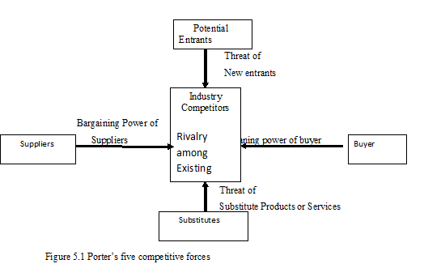

Slide 9
Bargaining Power of Suppliers
Supplier power is likely to be high
when there are only few suppliers giving an entrepreneur few options to shop for inventory.
Whenever suppliers are few in number
When products are not substitutable each other
Bargaining Power of Buyers
Under the following conditions buyers influence producers:
Whenever buyers are few in number and purchase in large volume relative to the total industry sales.
Whenever products are not differentiated and can be easily substituted
When switching cost of buyers is low
When buyers have the ability to integrate backward and start to produce its input internally.

Slide 10
Rivalry among Existing Firms
It is concerned with competition among existing firms. This depends on:
Size of firms -When firms have relatively similar size (either small or large), each of them can make similar type of decision.
Perishability of products- If organizations are engaged in selling perishable products, they sell their products at the existing price.
Low switching cost of buyers- tends to increase competition among existing firms.
Attractiveness of the industry in terms of profit-when the industry is profitable, it attracts more competitors and competition increases.
The numbers of firms in the industry –When there are many firms (when firms are many in number), competition will increase.

Slide 11
Availability of Substitute products
When there are products which either serve similar purpose or satisfy similar needs and wants of customers.
Barriers to Entry
It includes forces that protect position of a firm from other or new competitors (entrants).
Capital requirement-
Economies of scale-
Reputation and good will of existing firms-
Switching cost of buyers –When buyers assume low switching cost-entry will be easy.
-difficult When switching costs are high
Differentiation
Customer’s loyalty-
Regulatory forces-The extent to which the government protects the industry. Example, media, telecommunication, banks

Slide 12
Marketing Strategy
Organizations can achieve their objectives in two ways. They can better manage what they are presently doing and/or find new things to do.
In choosing either or both of these paths, the organization must then decide whether to concentrate on present customers or to seek new ones, or both.
Accordingly the following four marketing strategies are identified;
market penetration,
market development,
product development and
diversification.
A two dimensional model known as Ansoff’s product/market matrix is developed to analyze alternative strategies available to an organization for achieving its objectives.

Slide 13
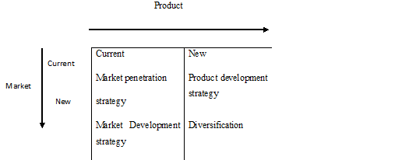
Ansoff’s product/market matrix (Organizational Growth strategies)

Slide 14
1. Market penetration strategies
These strategies pursued for present market and product.
focus on improving the position of the organizations present products with its present customers and are effective when the market is growing or become saturated for existing products.
There are three major approaches to increase current product’s market share in the current market.
Encourage existing customer to buy more of the product.
Attract competitor’s customers through attractive promotion
Convince non-users of the product to use the product.
tactics : price reduction, advertising that stresses the different benefits of the product, packaging the product in different sized packages or making the product available in different locations.

Slide 15
2. Market Development Strategy
This strategy seeks new market for the existing product. The strategy is that:
Enter in to a new geographical market
Identify a new marketing segment for current product
Use additional new distribution channels.
For example:
A government social service agency may seek individuals and families who have never utilized the agency’s services.
A manufacturer of automobiles may decide to sell automobiles in a new region which it has not entered before.
An athletic clothing and footwear company may decide to develop a line of fitness clothing for children

Slide 16
3. Product Development Strategy
This strategy may enforce management to consider some new product development possibilities such as: design and develop a new product, modify the quality of existing product, and modify the features of existing product. For example:
A candy manufacturer may decide to produce biscuits and offer to its customers.
A social service agency may offer additional services to present clients.
A hotel adds a new item in its menu.

Slide 17
4. Diversification
This strategy makes the business to be less dependent on one or few products in the market place. This strategy can also be pursued whenever there is a good opportunity outside the current business market and product.
Types of diversification
4.1 Horizontal integration
4.2 Vertical integration
4.3 Concentric diversification
4.4 Conglomerate diversification
1. Horizontal integration: in this type of diversification, a company adds up same type of products at the same level of production or marketing process. This may happen internally or externally. Internally, a company may decide to enter a parallel product market condition to the existing product line. Externally, a company combines with a competing firm. Two or more competing firms are brought together under single ownership and control.

Slide 18
2 Vertical integration: in this type of growth strategy new products or services are added which are complementary to the existing product or service line.
New products serve the firm’s own needs by either supplying inputs or serve as a customer for its output. It involves moving backward or forward from the present product or service. Linkages are established between products, processes or distribution systems.

Slide 19
3. Concentric diversification: when a firm enters into some businesses, which is related with its present business in terms of technology, marketing or both, it is called concentric diversification. It is employed for one of the following purposes
To counteract cyclical fluctuations in the present products or services
To utilize the cash flows generated by the existing products or services
To face saturation of demand for present product or service
To gain managerial expertise in new fields of business or services
To capitalize on the reputation of present product or service

Slide 20
4. Conglomerate diversification: in this growth strategy, a firm enters into business, which is unrelated to its existing business both in terms of technology and marketing. It may be adopted for the following reasons:
to achieve a growth rate higher than what can be realized through expansion
to make better use of financial resource with retained profits exceeding immediate investment needs
to avail of potential opportunities for profitable investment
to achieve distinctive competitive and greater stability and
to spread the risk

